Slide 1


Slide 2
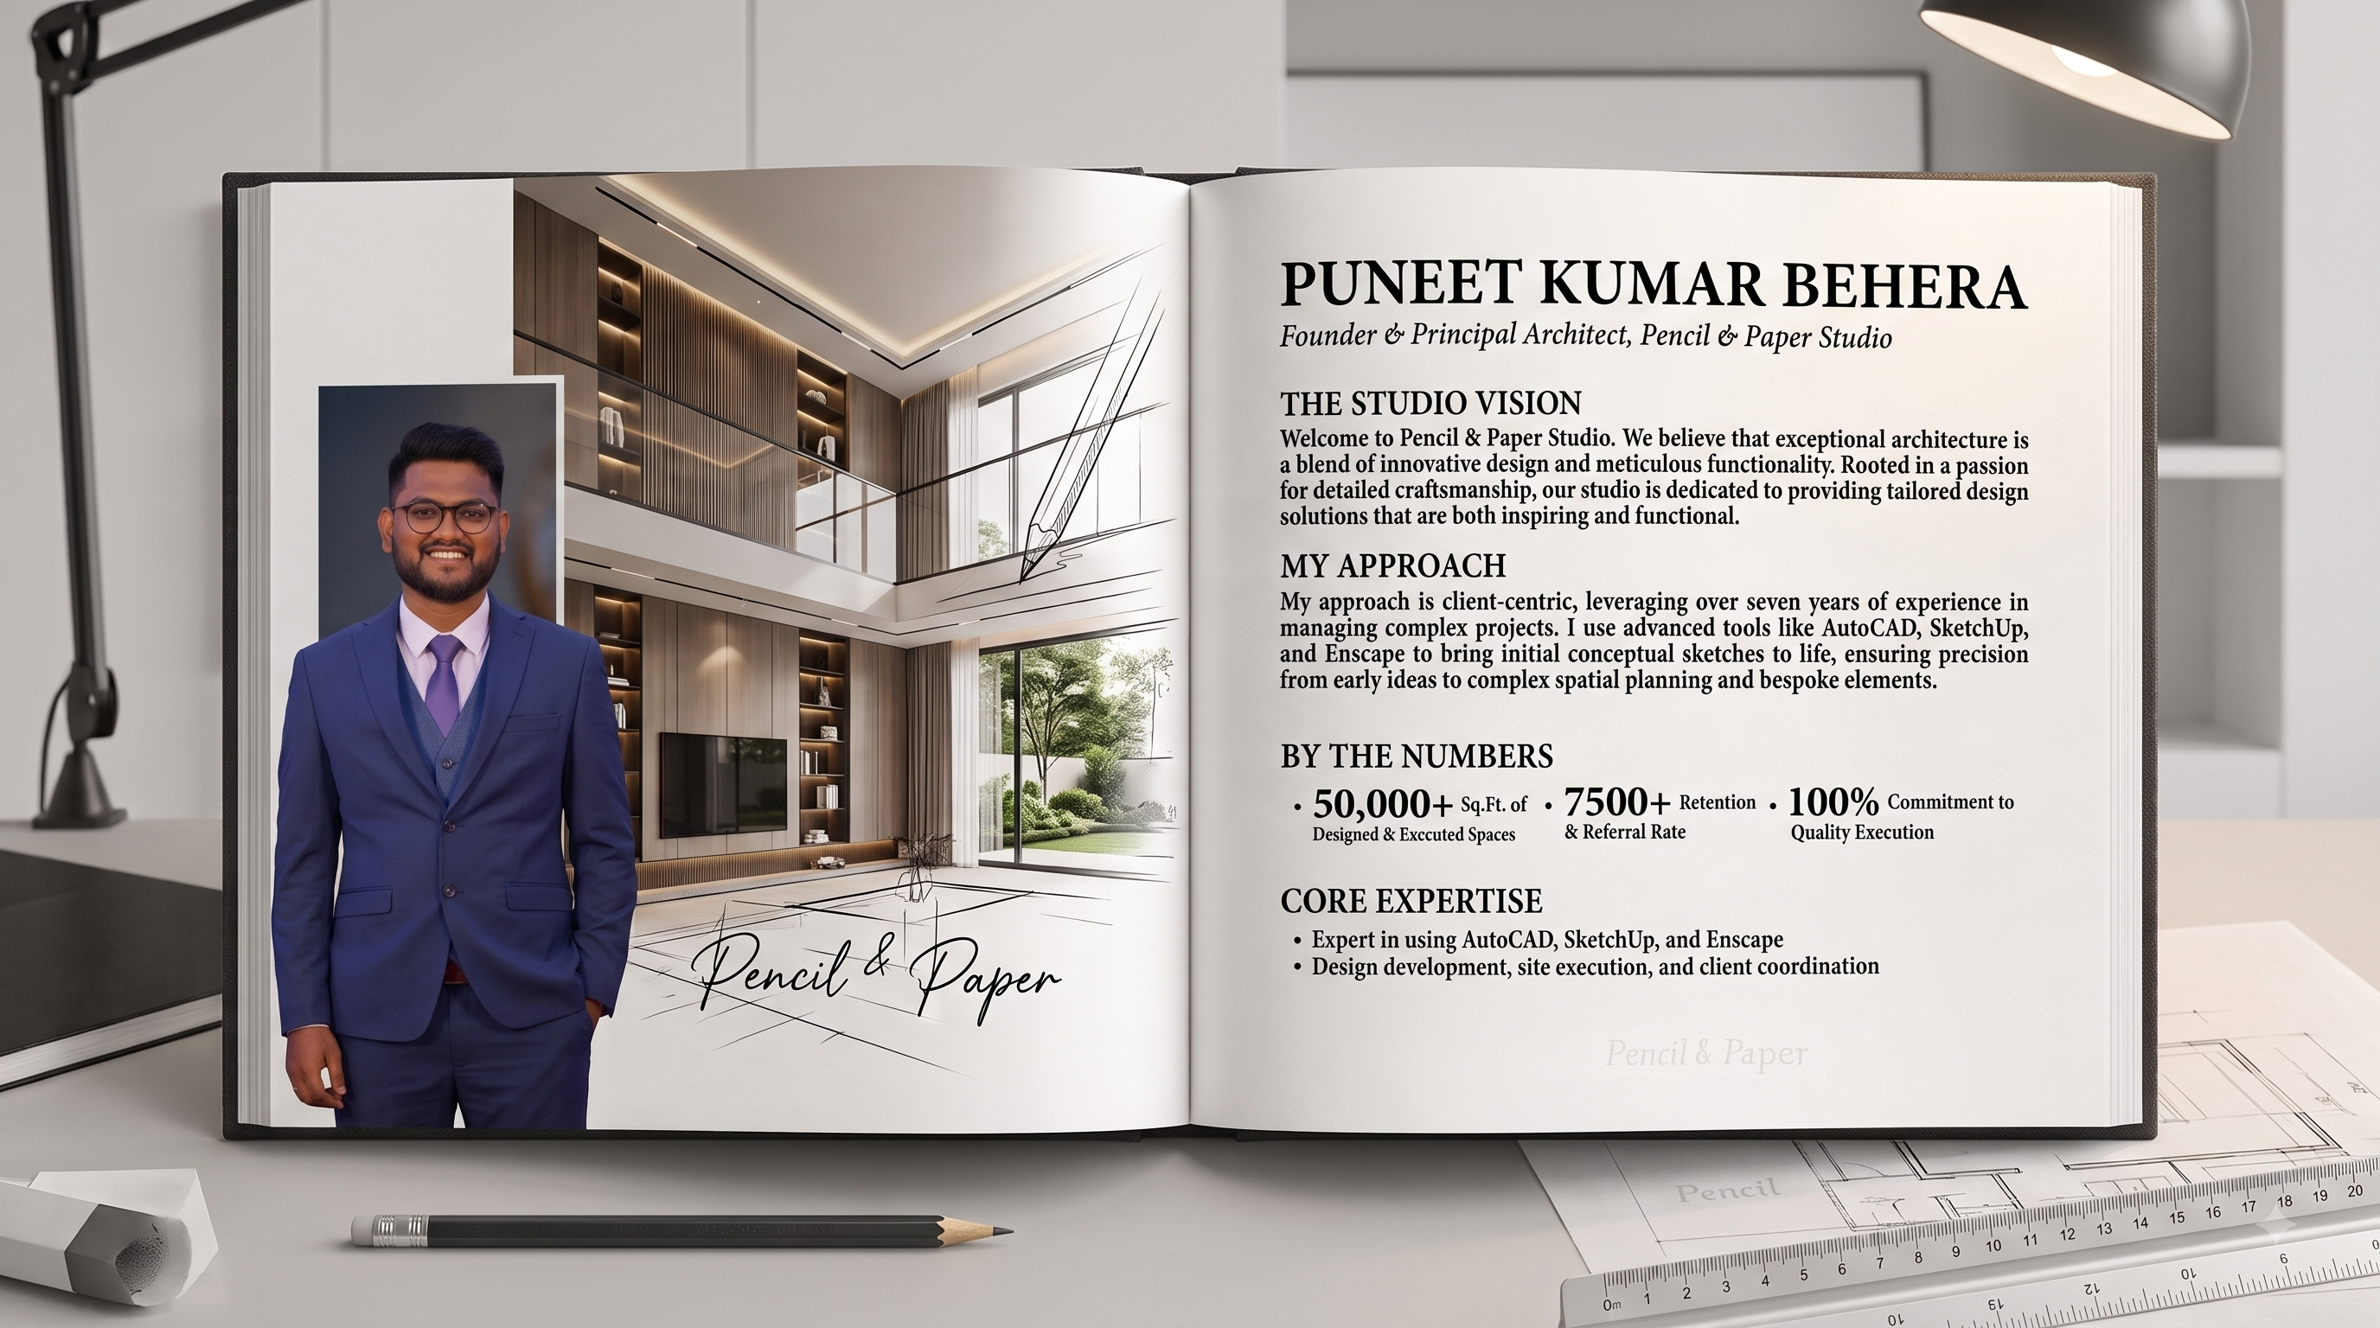

Slide 3


Slide 4
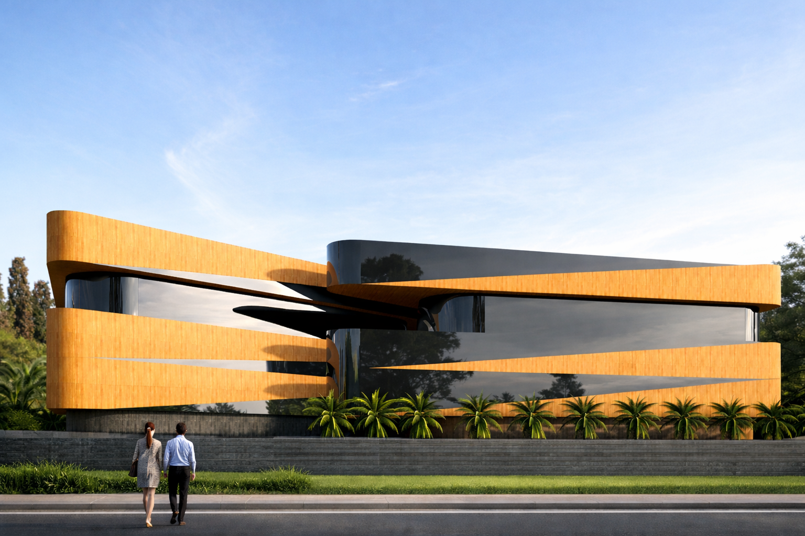
MIXED-USE COMMERCIAL HOTEL ODISHA

Slide 5
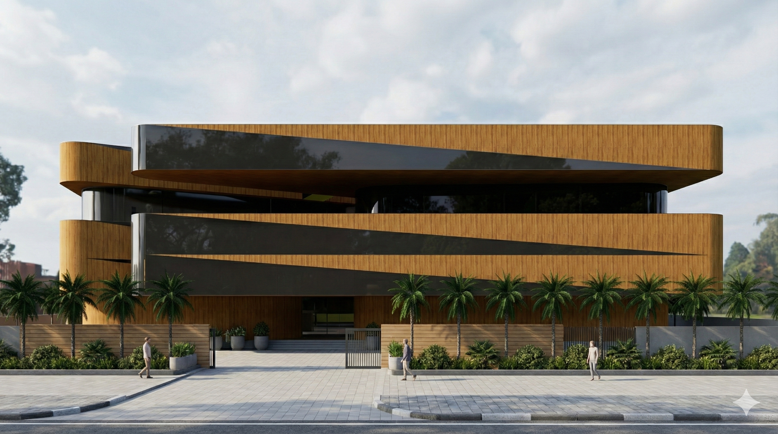
MIXED-USE COMMERCIAL HOTEL ODISHA

Slide 6
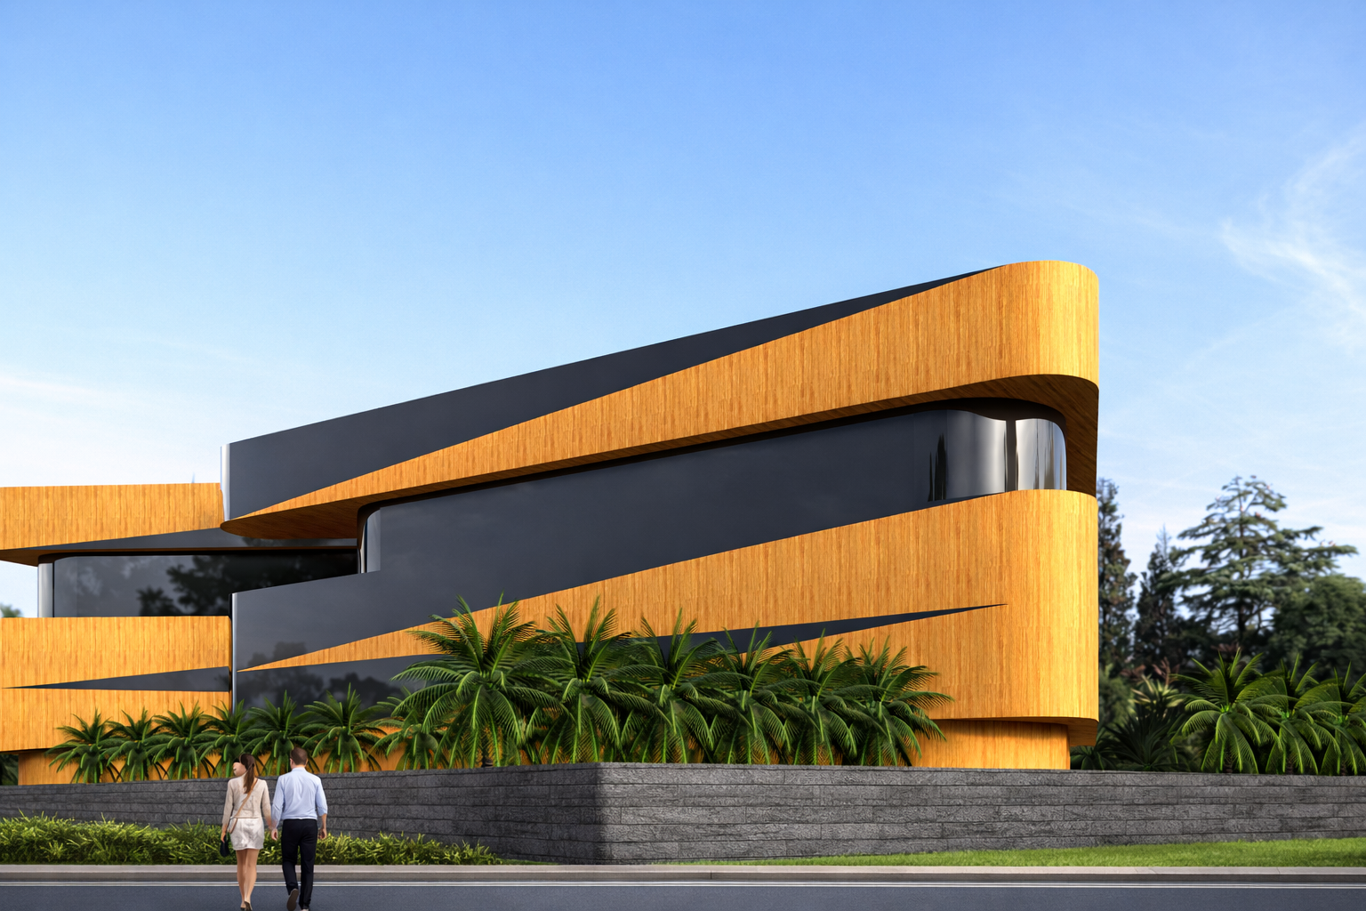
MIXED-USE COMMERCIAL HOTEL ODISHA

Slide 7
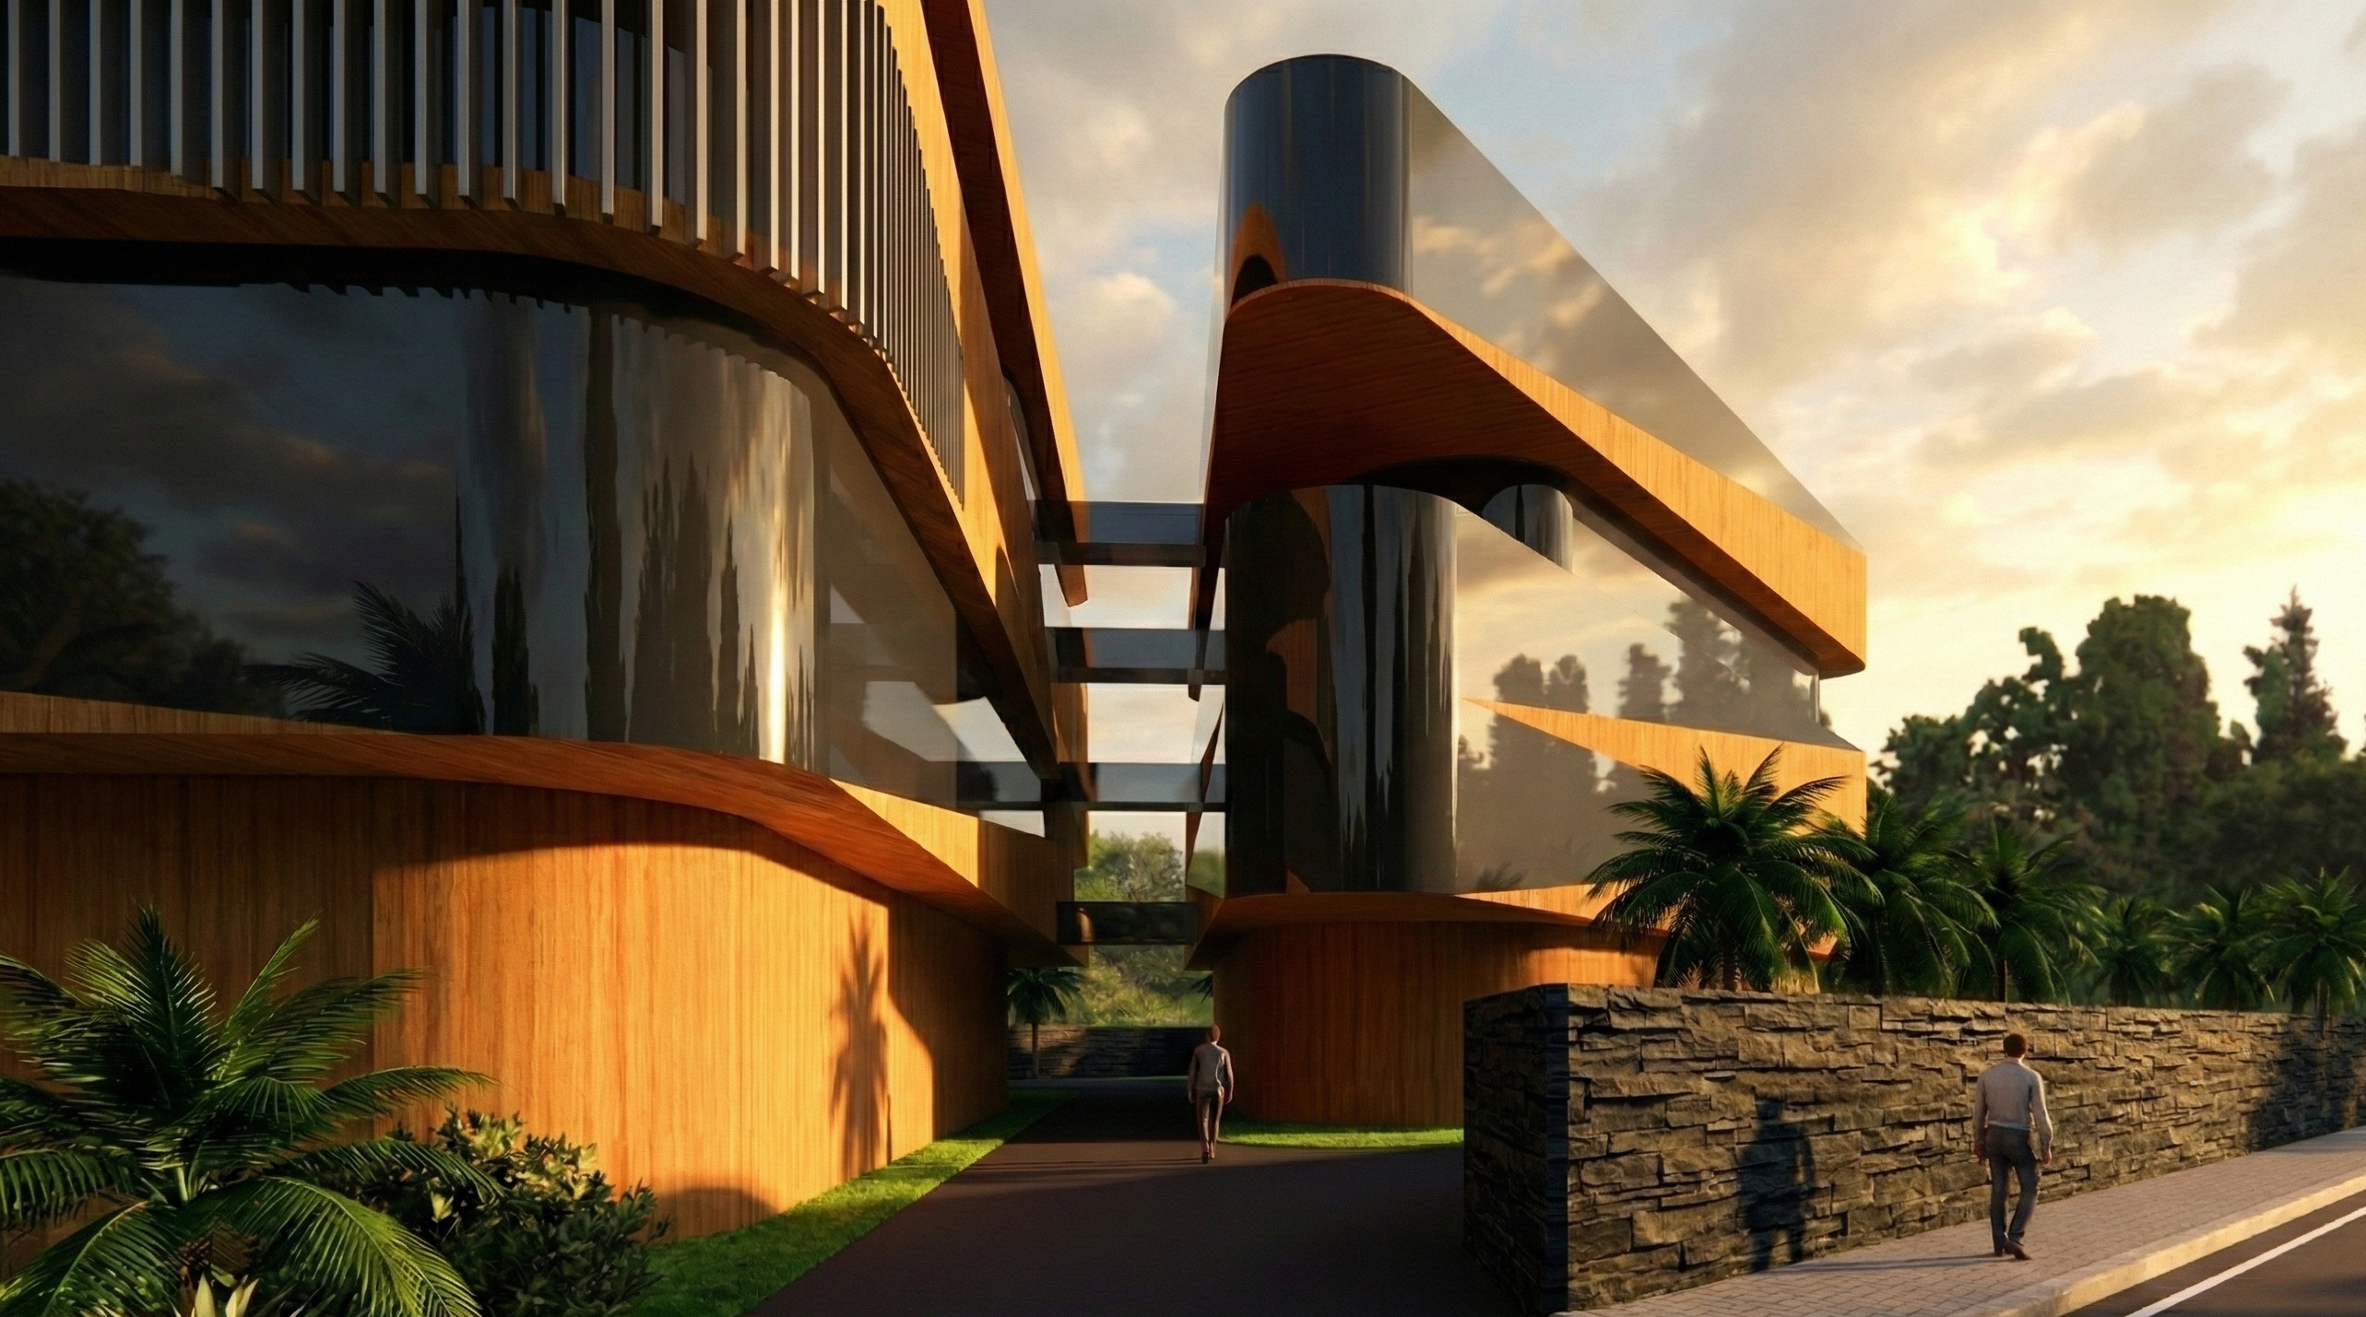
MIXED-USE COMMERCIAL HOTEL ODISHA

Slide 8
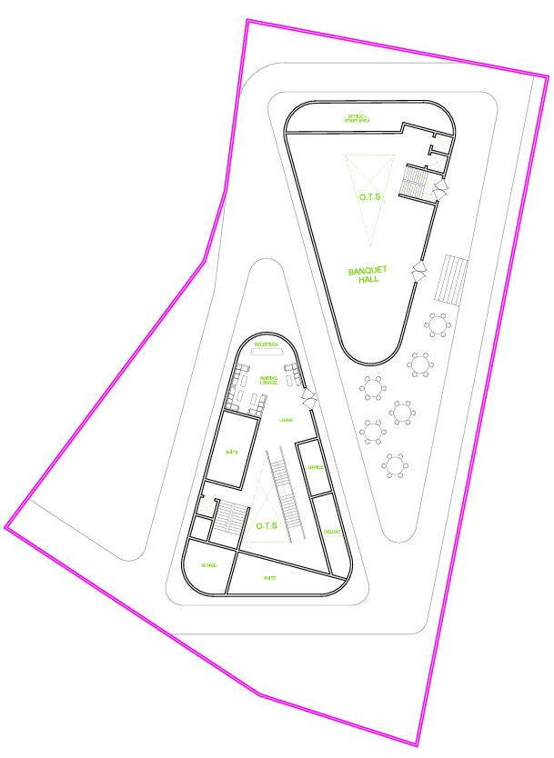
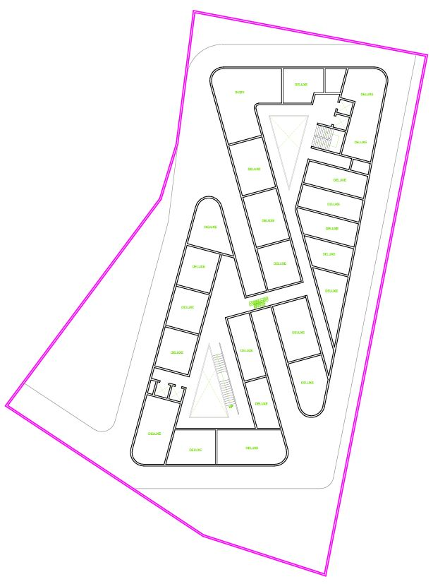

Slide 9
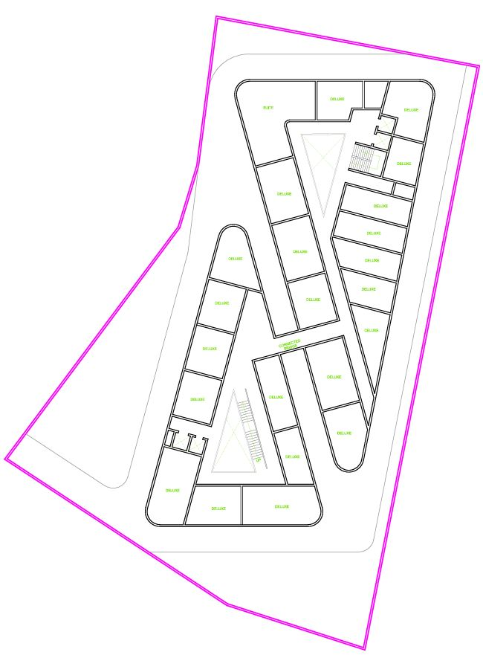
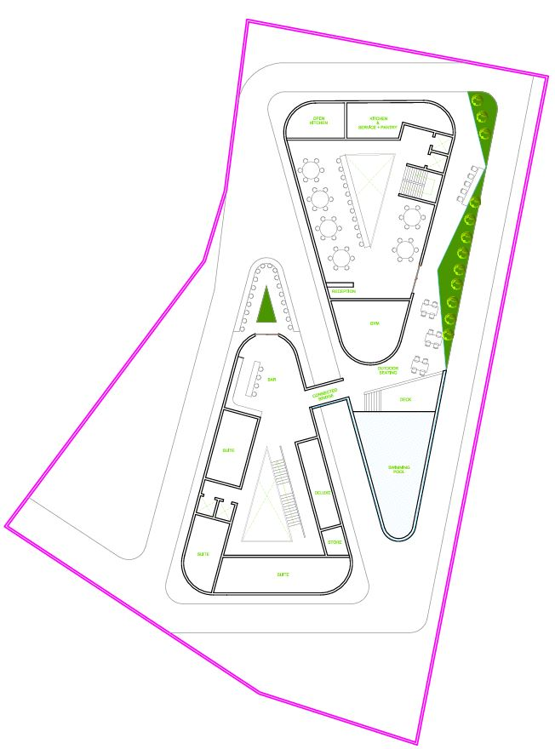

Slide 10
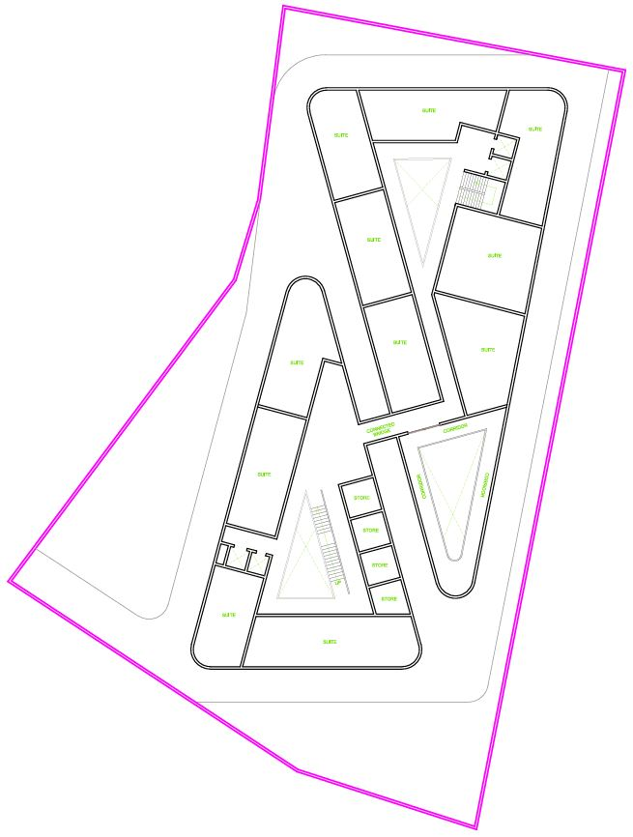
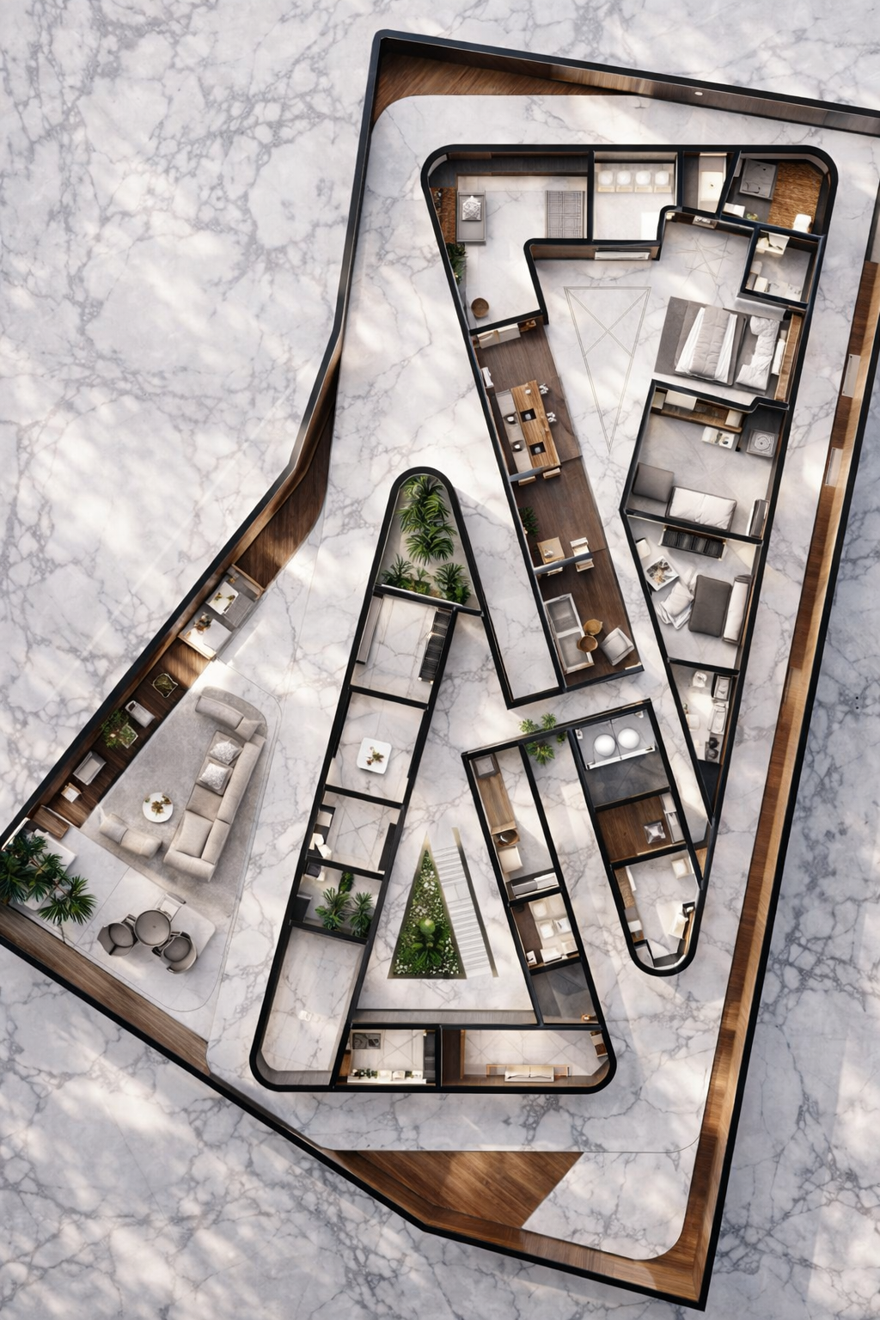

Slide 11
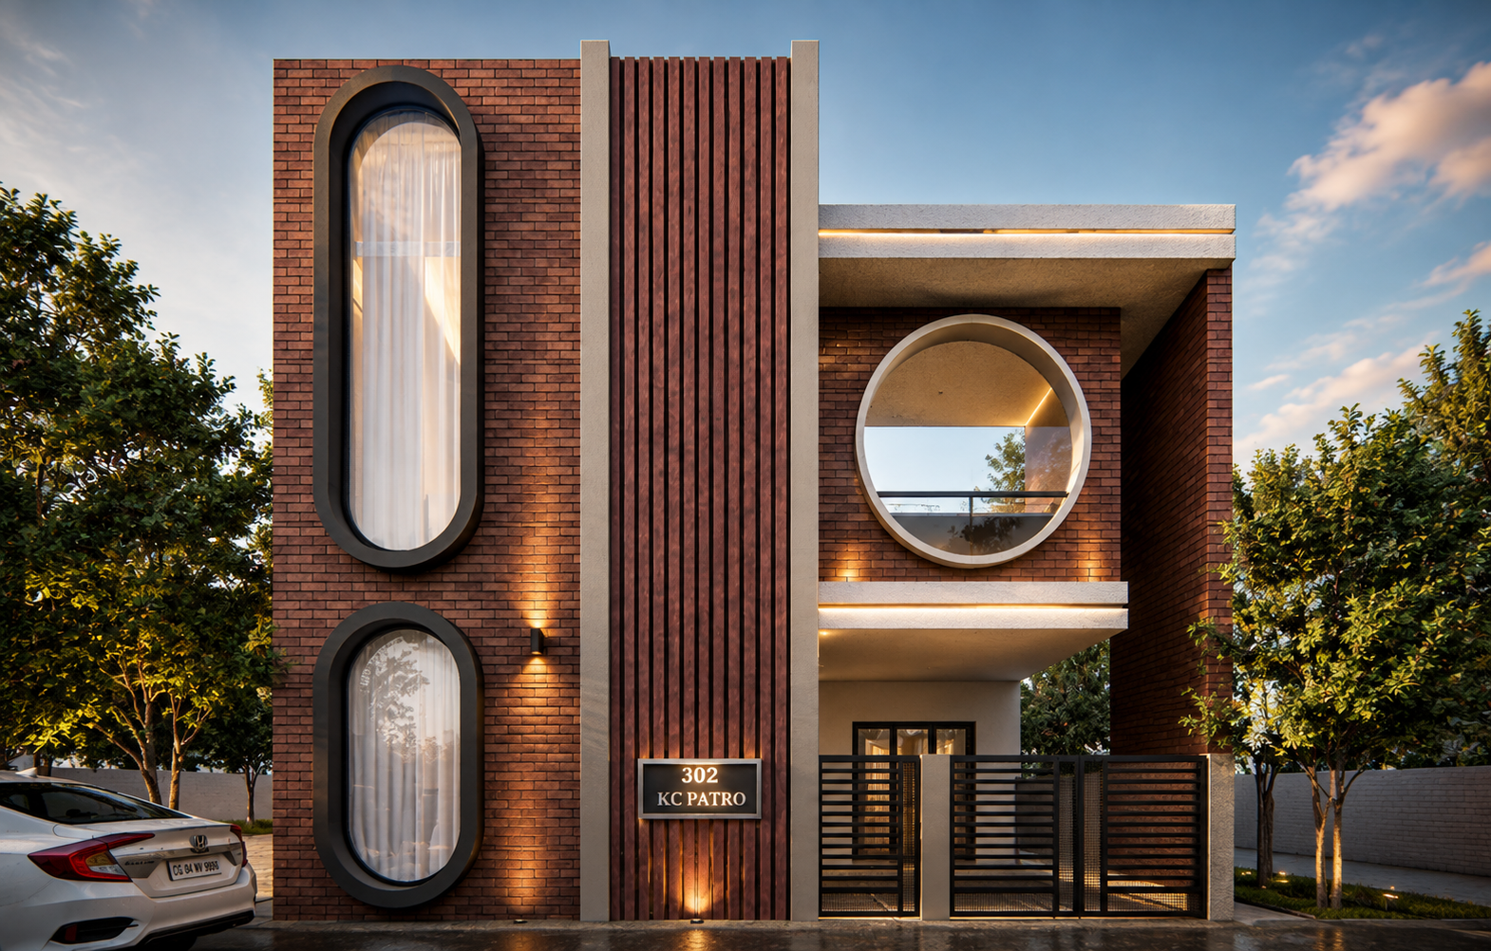
40 FEET NARROW HOUSE
ODISHA

Slide 12
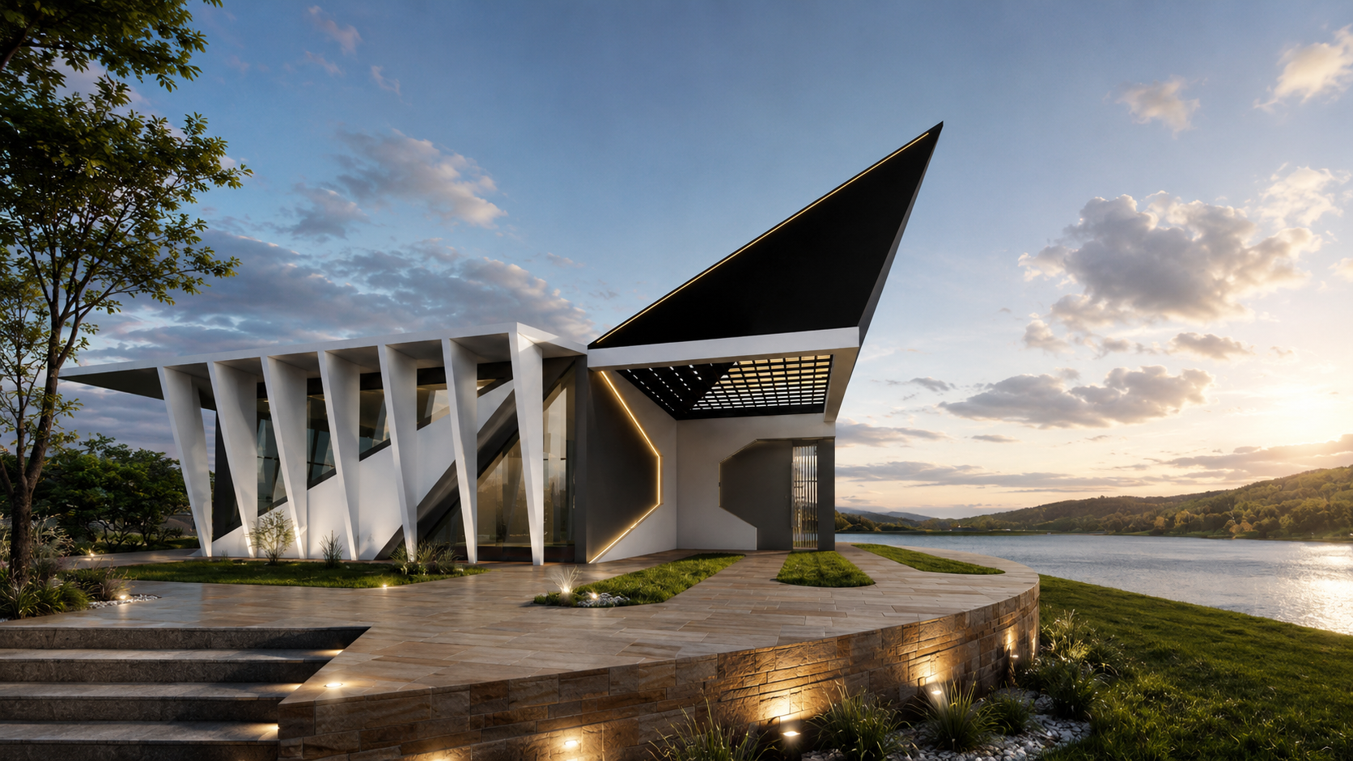
BIJU PATTNAIK MUSEUM
BIJU PATTNAIK MUSEUM

Slide 13
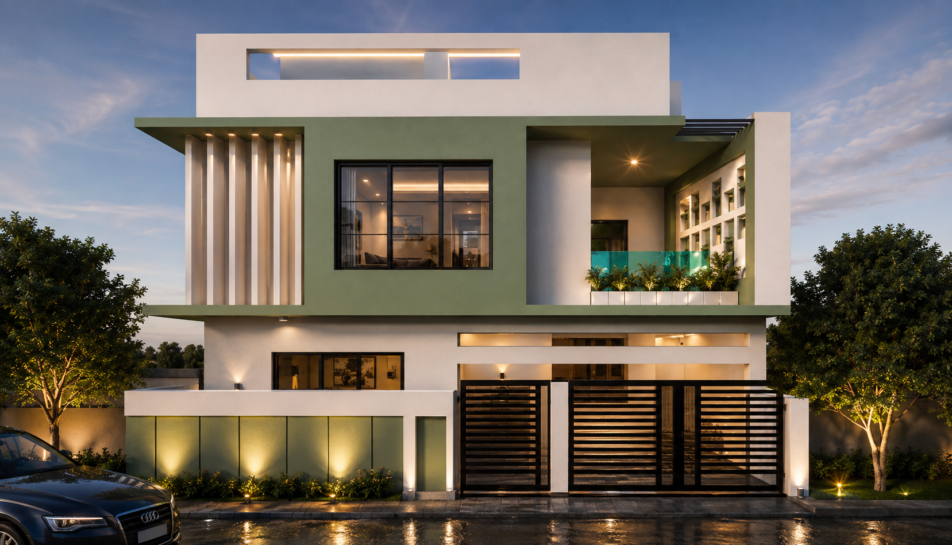
50 FEET WIDE HOUSE
ODISHA

Slide 14
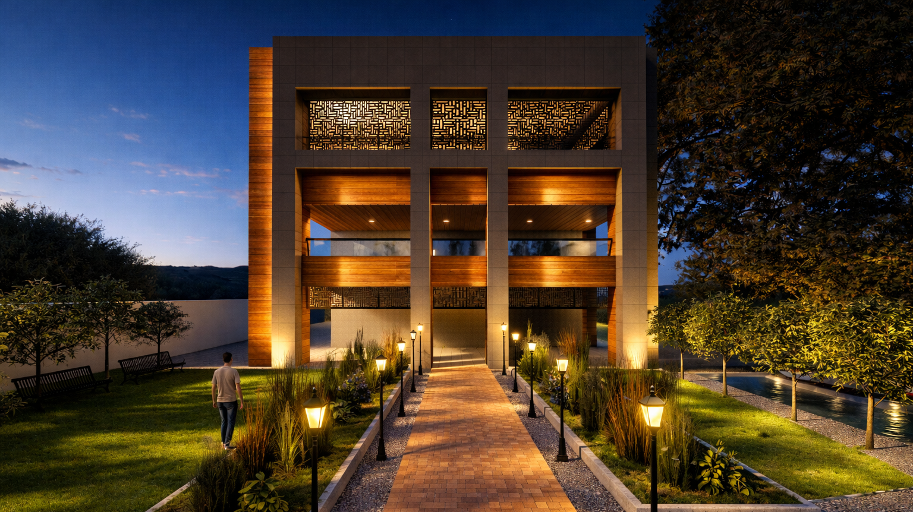
FARMHOUSE RENOVATION
ODISHA

Slide 15
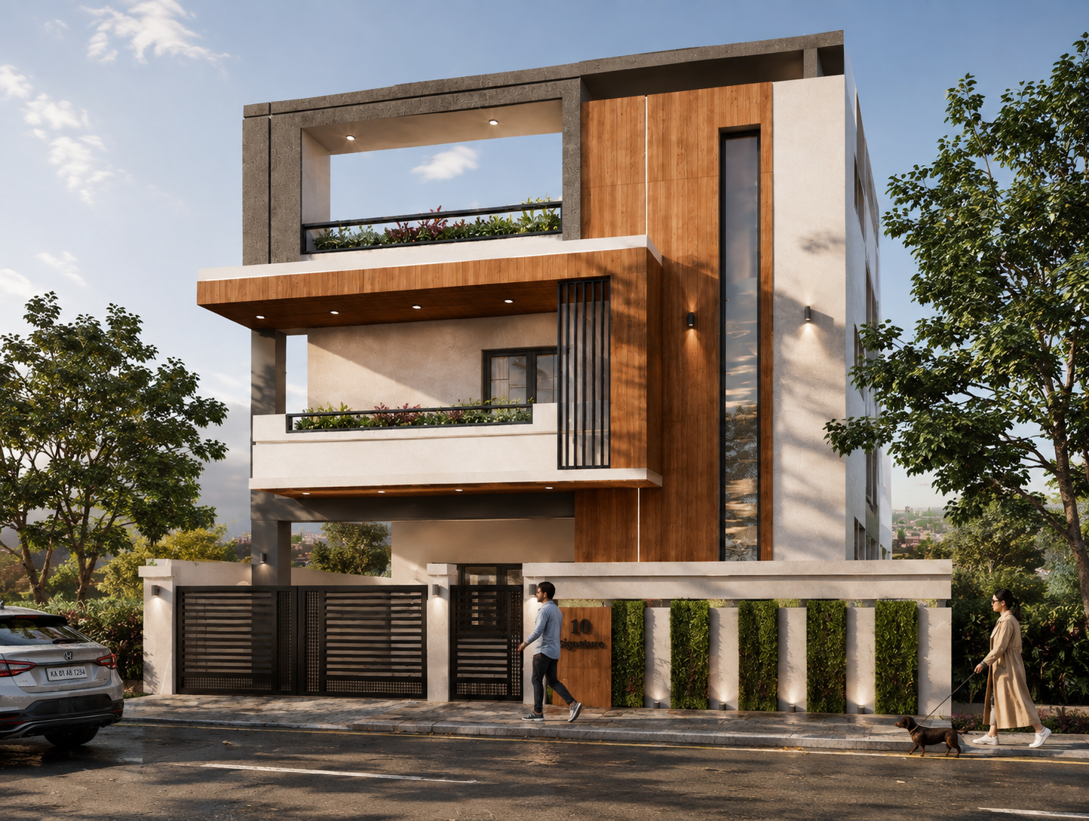
FARMHOUSE RENOVATION
ODISHA
40 FEET WIDE HOUSE
ODISHA

Slide 16
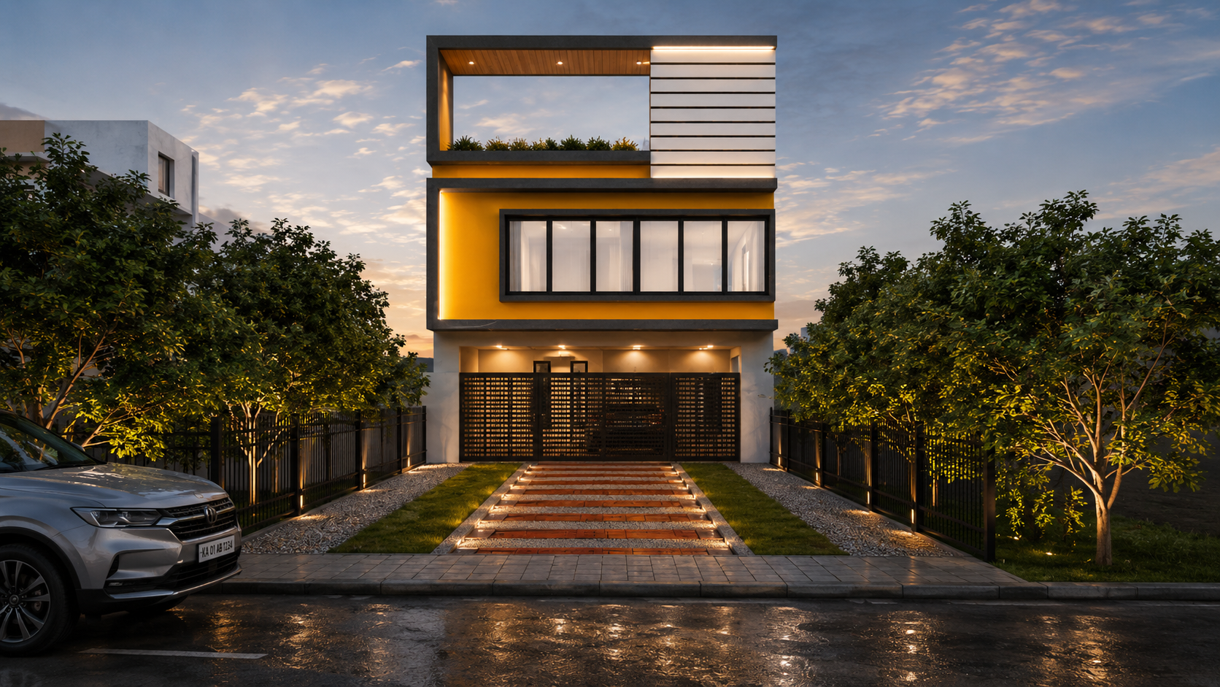
25 FEET WIDE NARROW HOUSE
ODISHA

Slide 17

UNISEX SALON
ODISHA

Slide 18
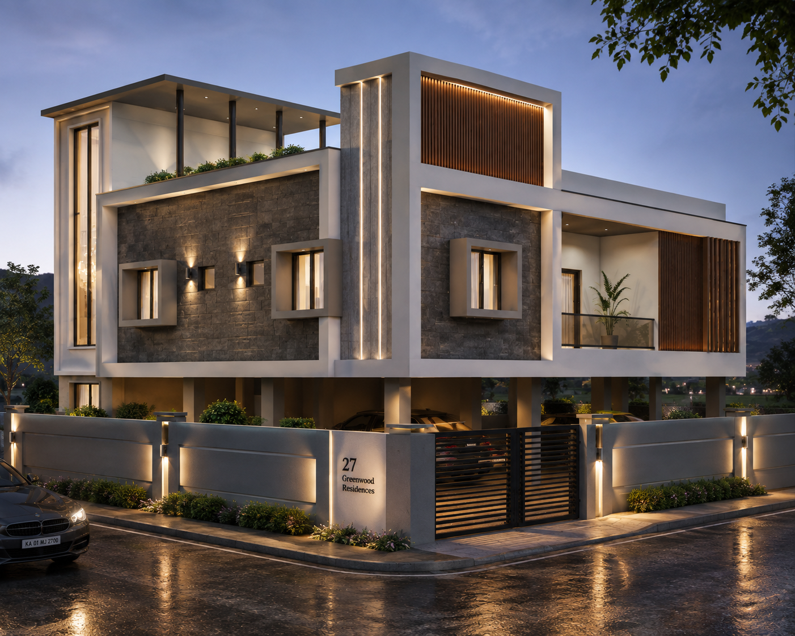
5000 SQFT HOUSE
ODISHA

Slide 19
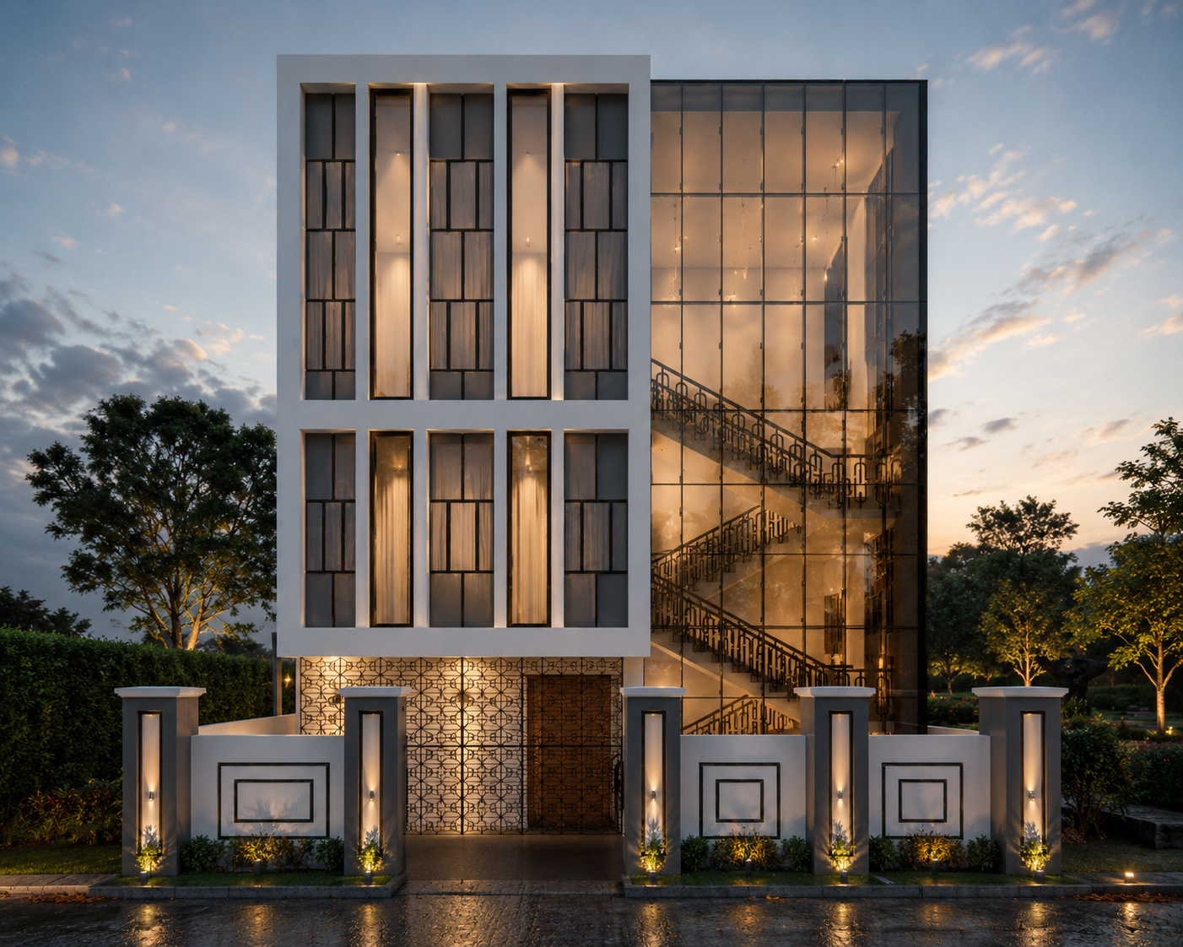
30 FEET WIDE HOUSE
ODISHA

Slide 20
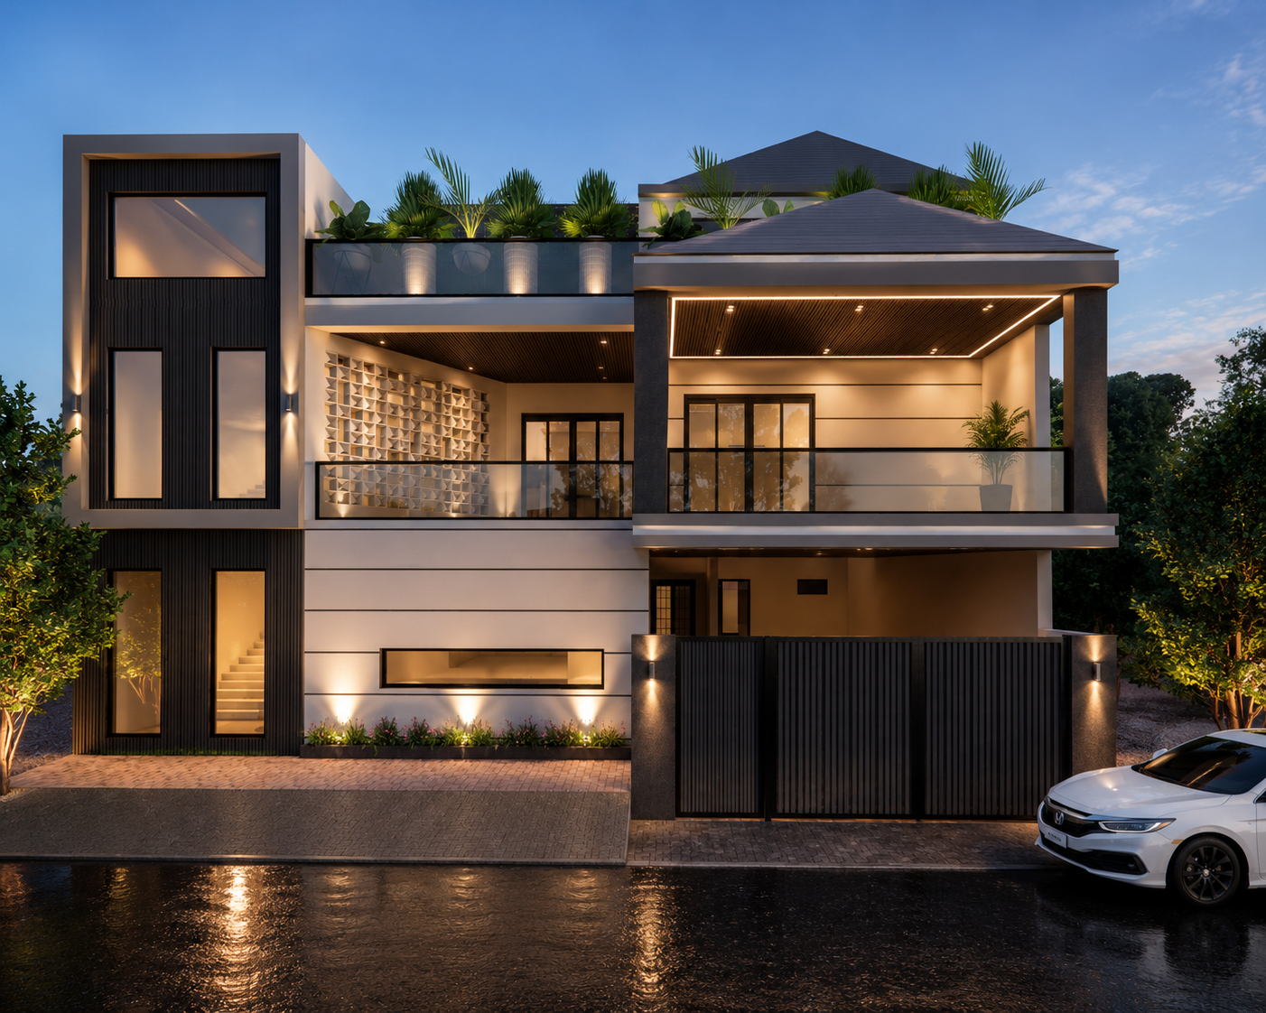
5000 SQFT HOUSE
ODISHA

Slide 21
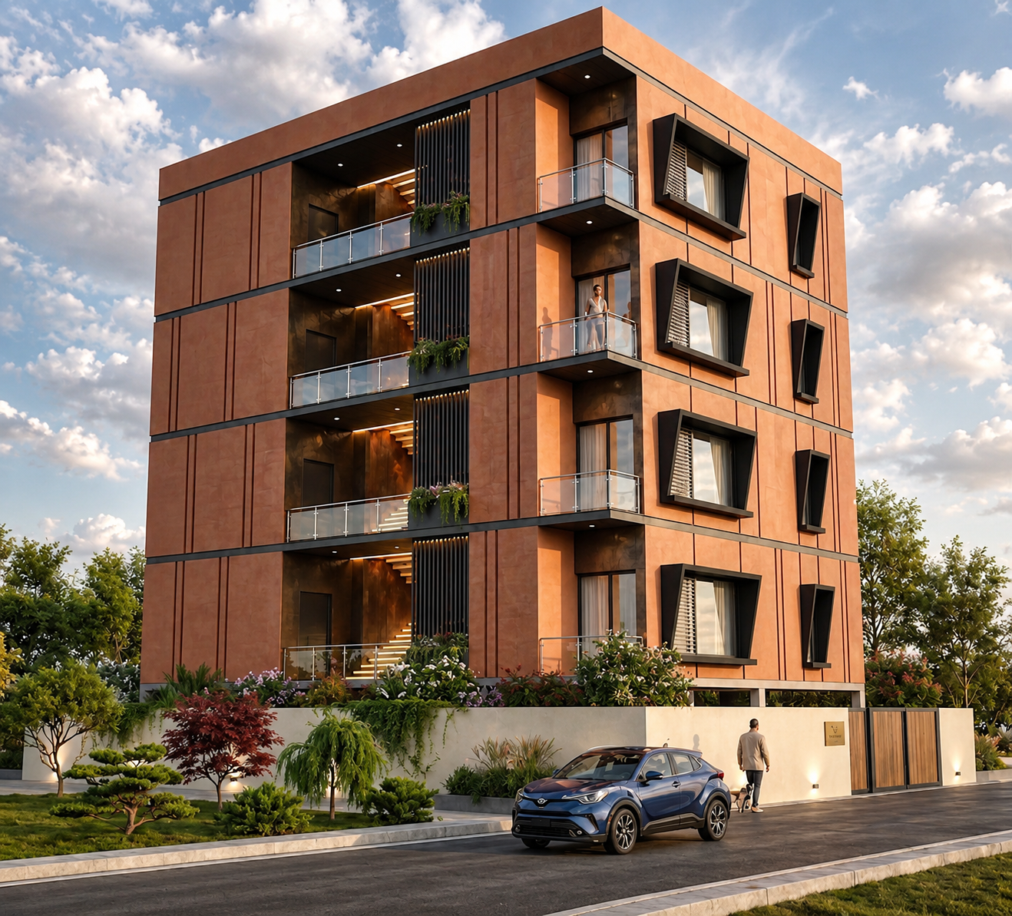
RESIDENTIAL APARTMENT
ODISHA

Slide 22
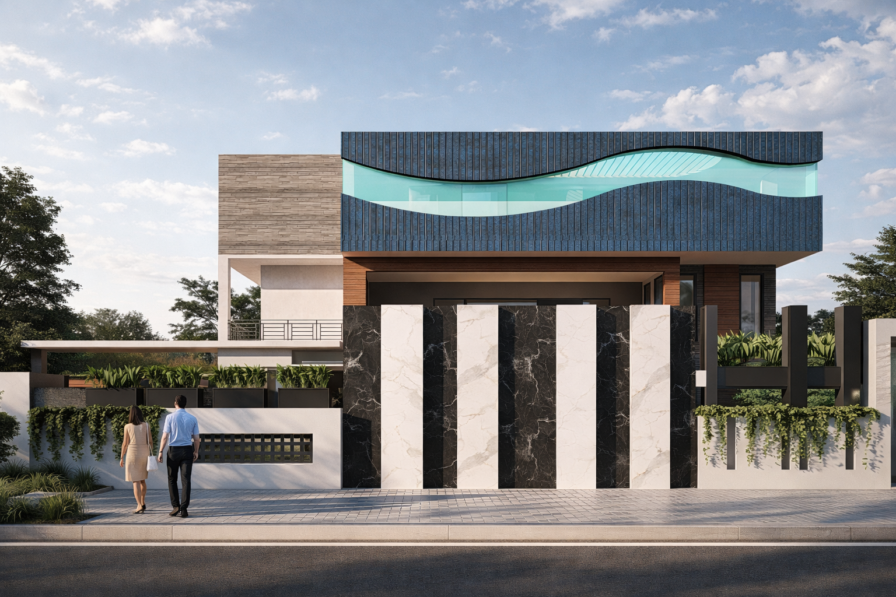
25000 SQFT RESIDENTIAL BUILDING ODISHA

Slide 23
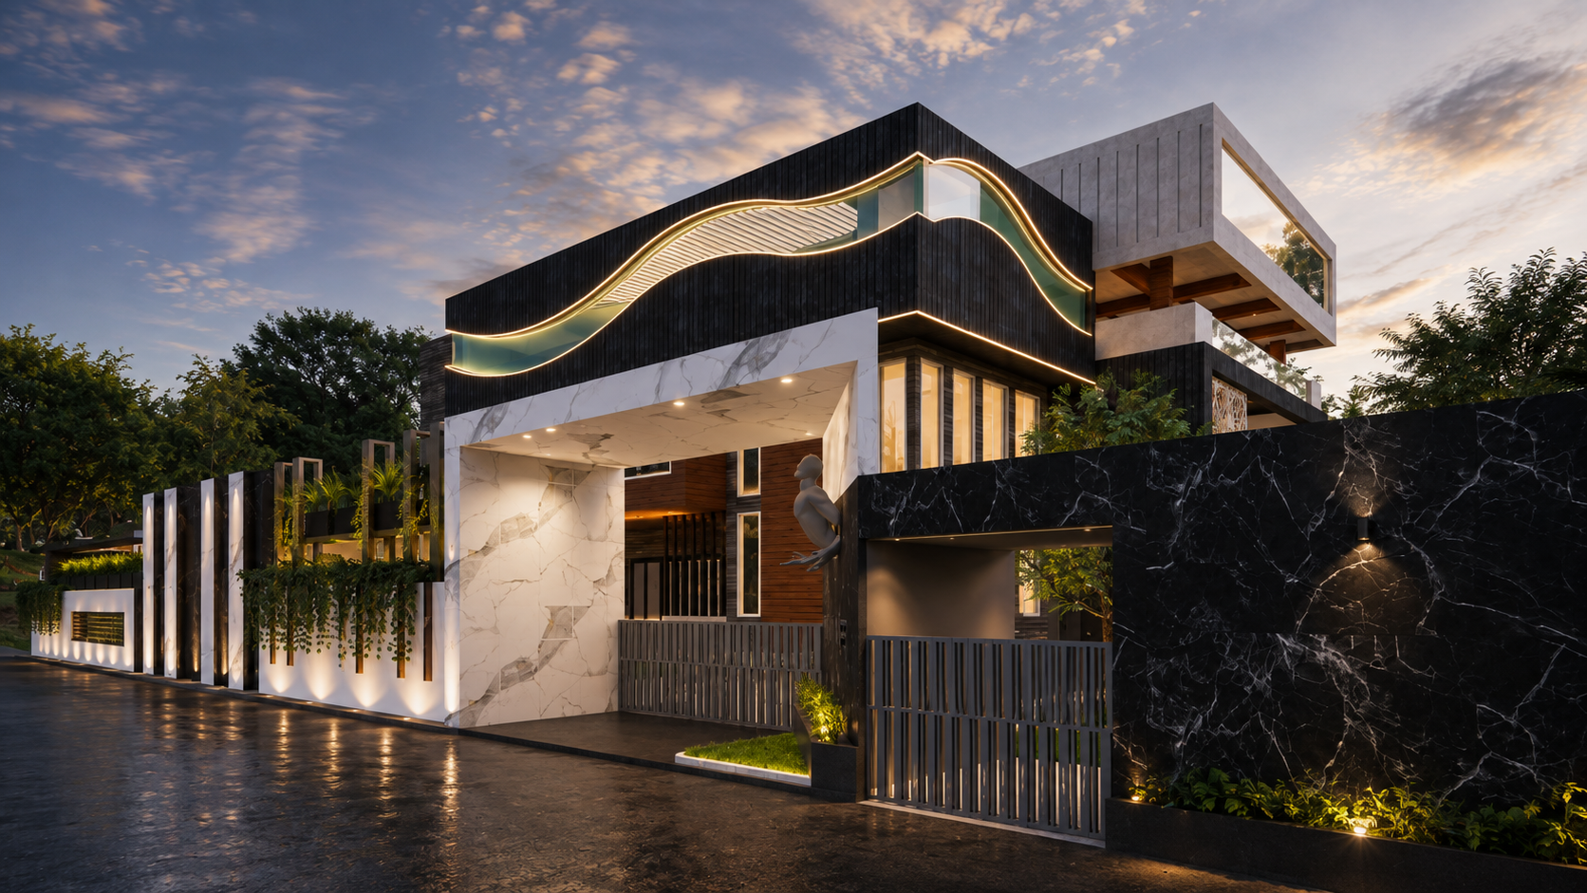
25000 SQFT RESIDENTIAL BUILDING ODISHA

Slide 24
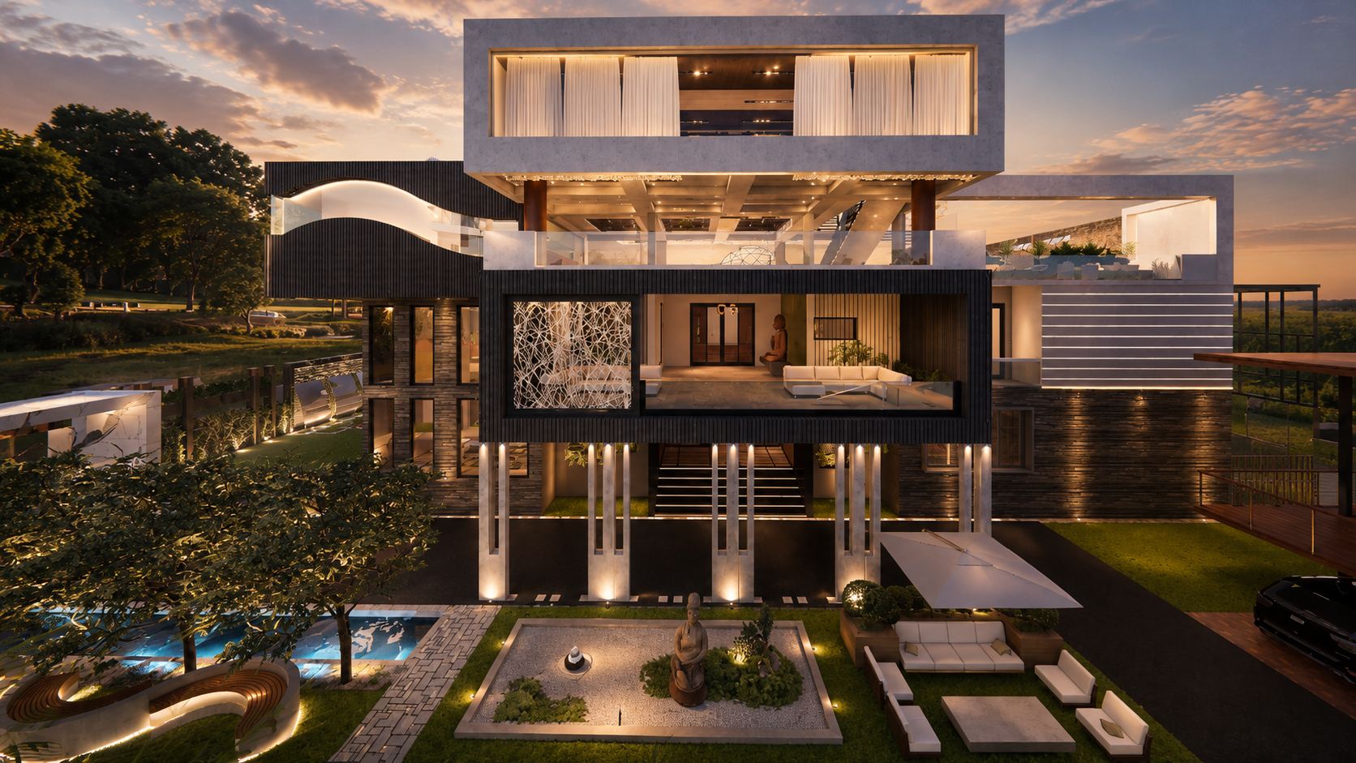

Slide 25
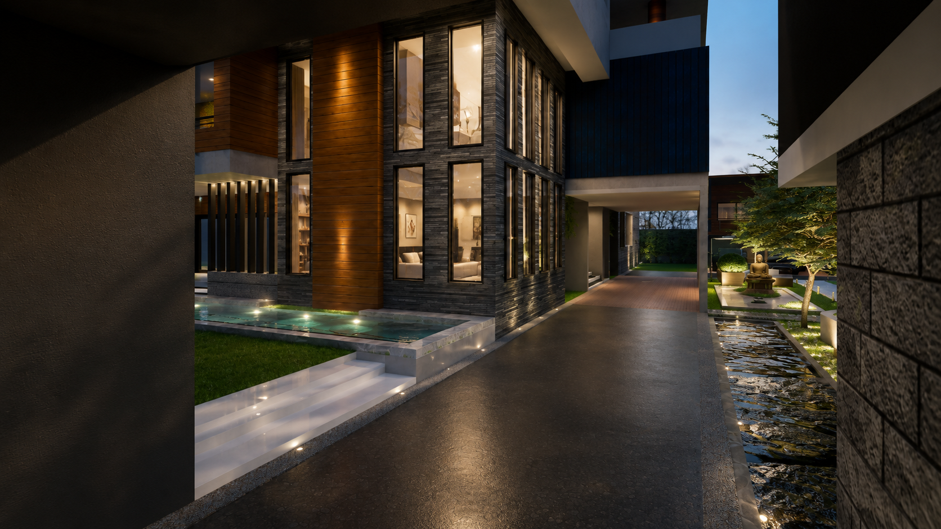

Slide 26
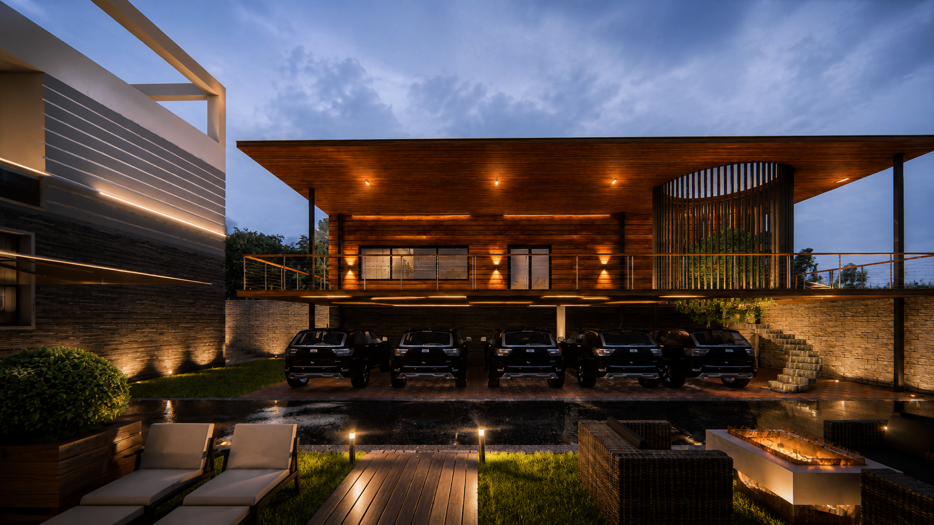

Slide 27
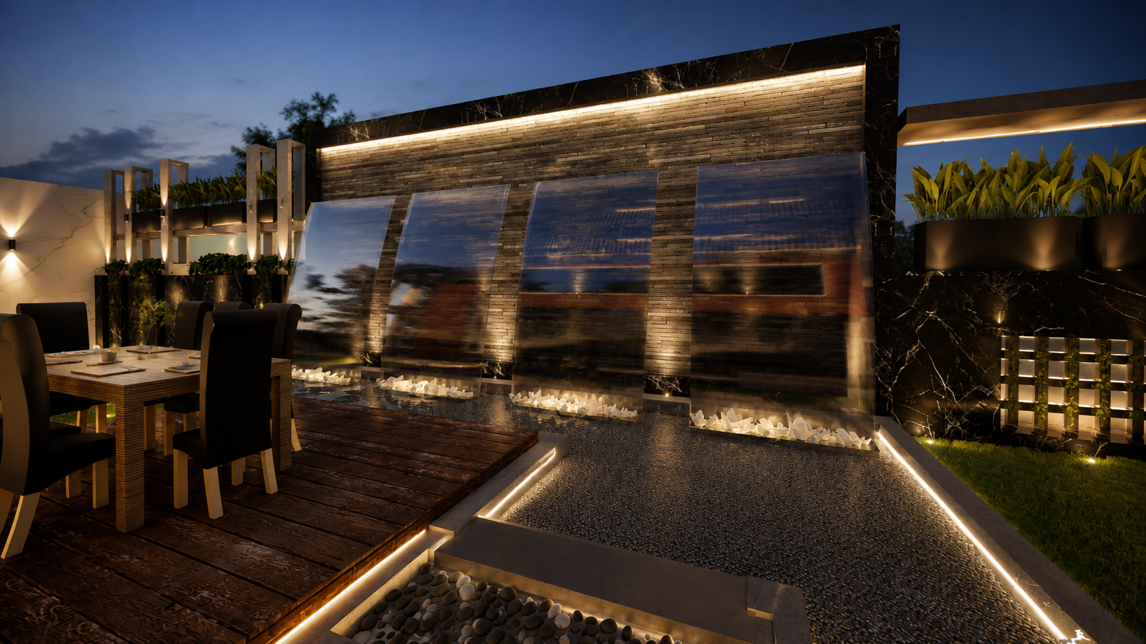

Slide 28
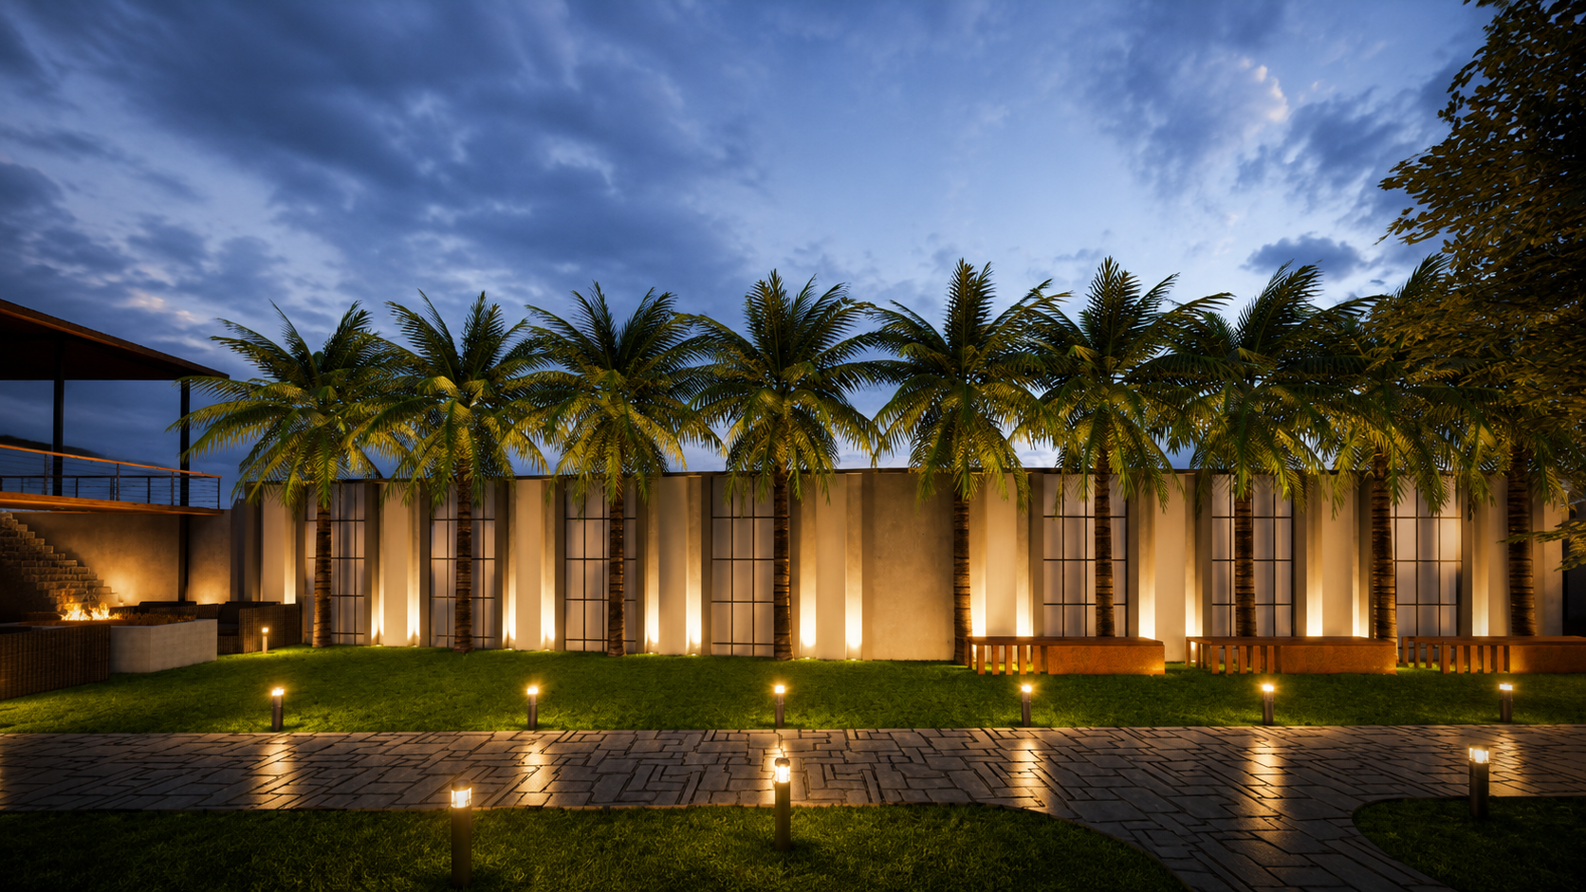

Slide 29
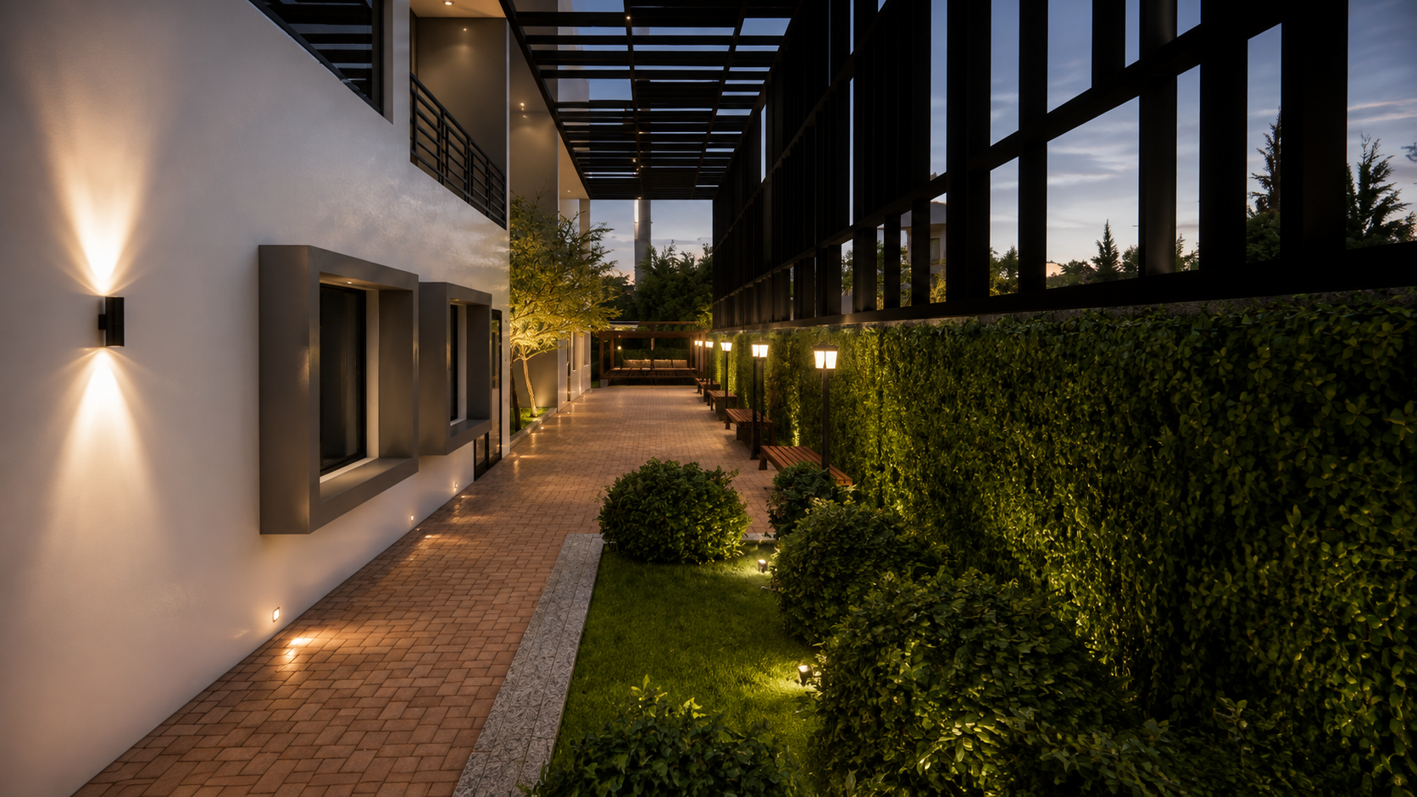

Slide 30
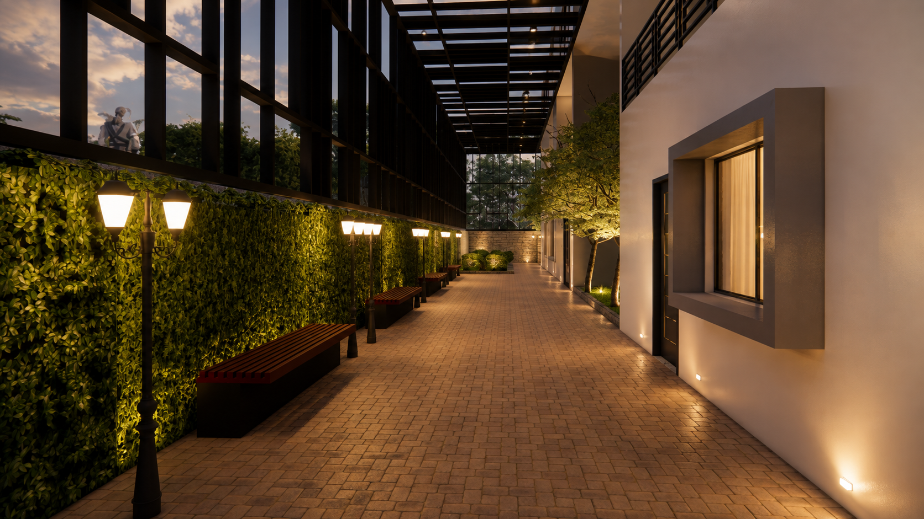

Slide 31
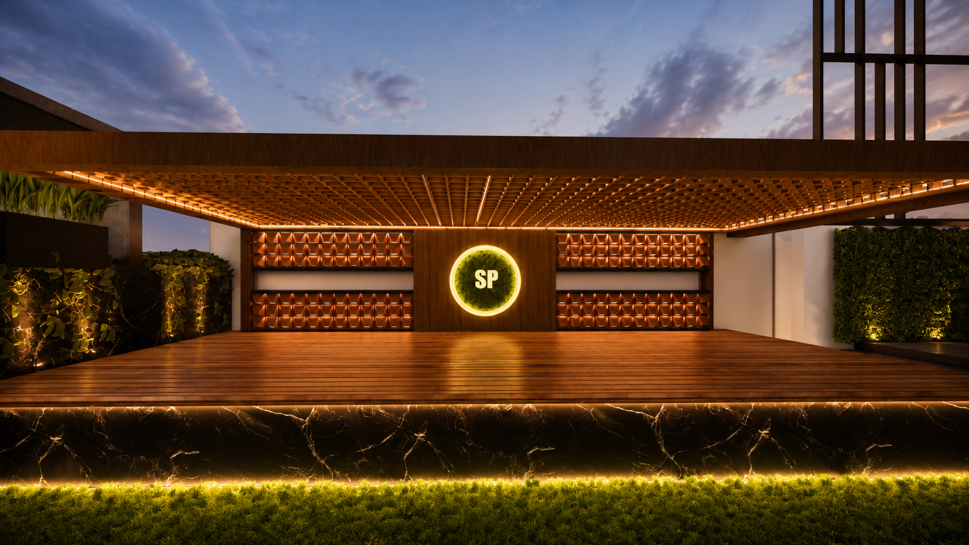

Slide 32
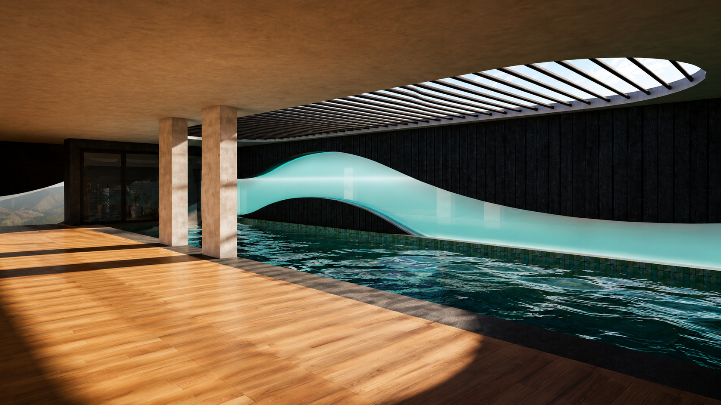

Slide 33
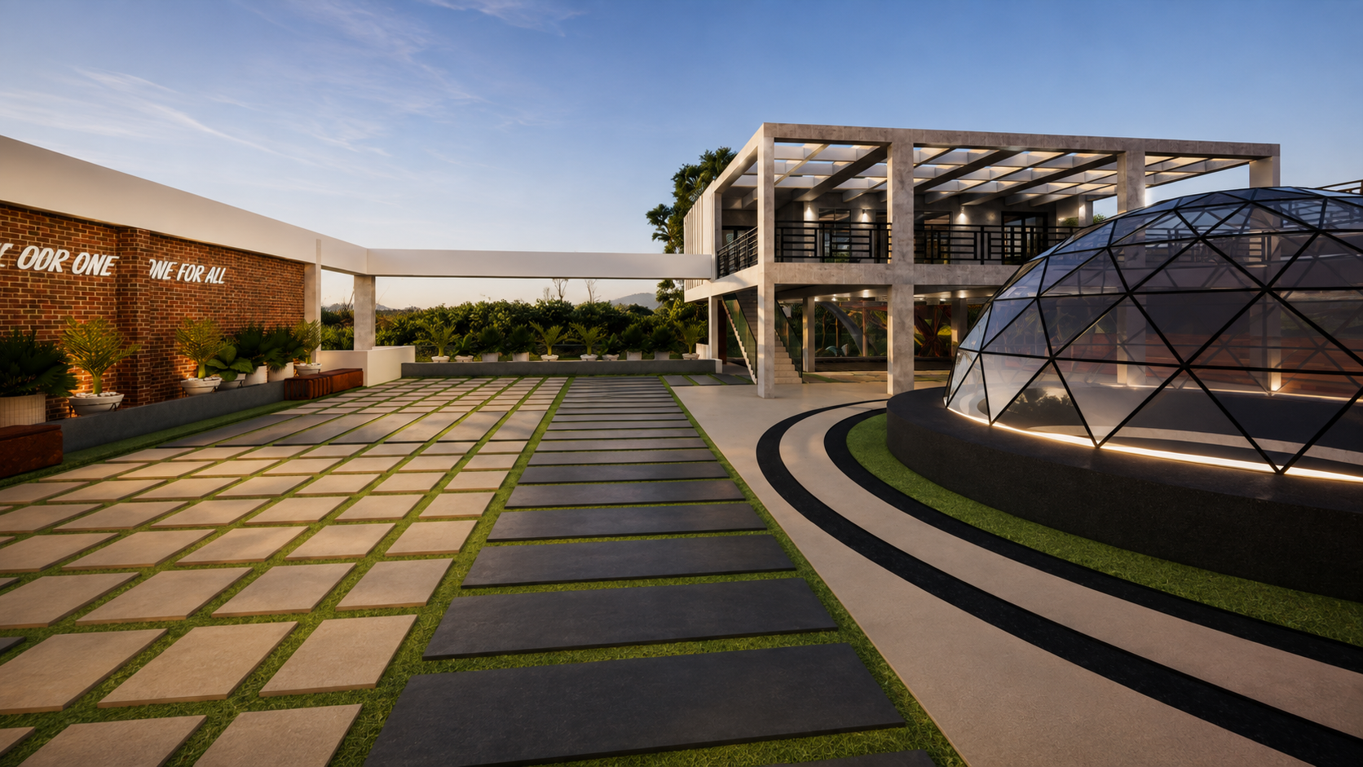

Slide 34
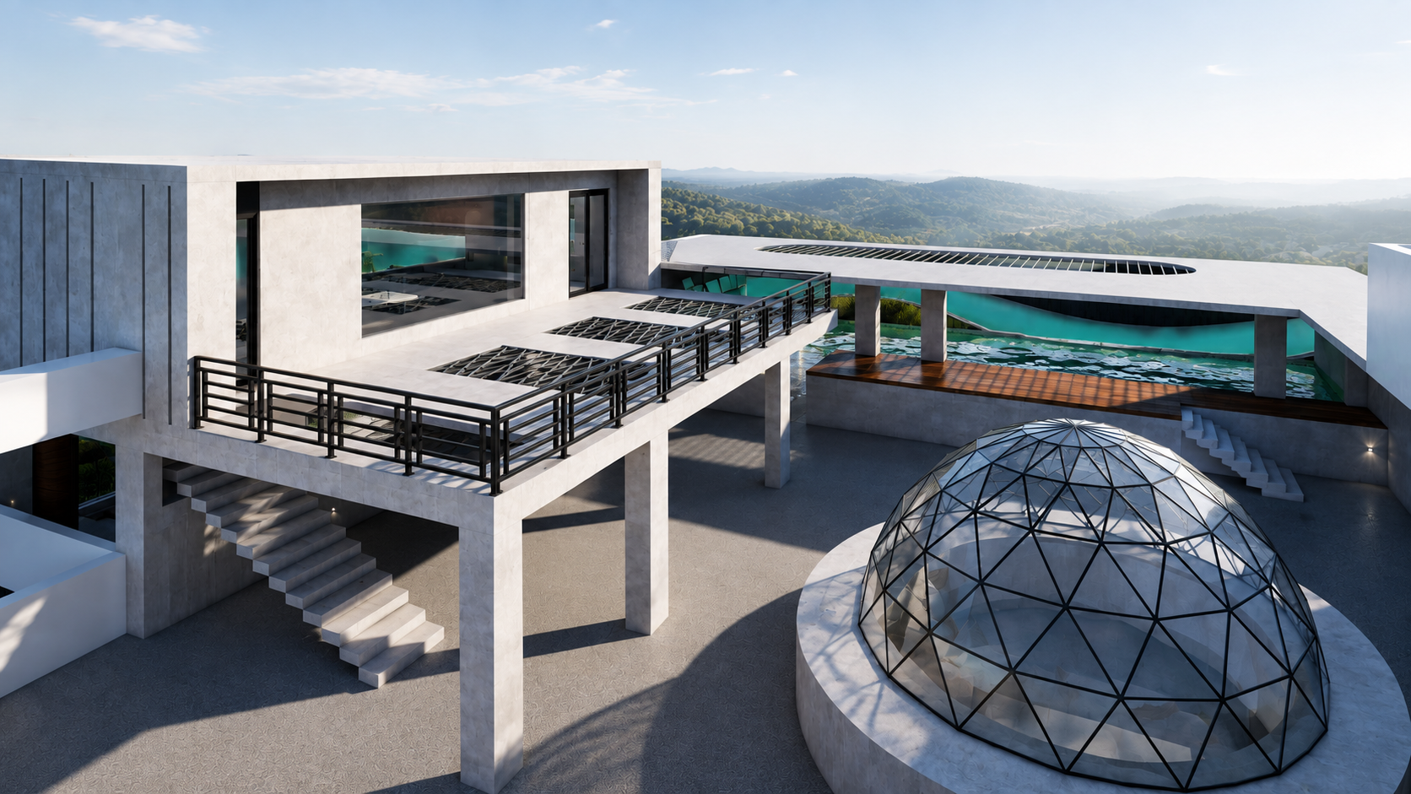

Slide 35
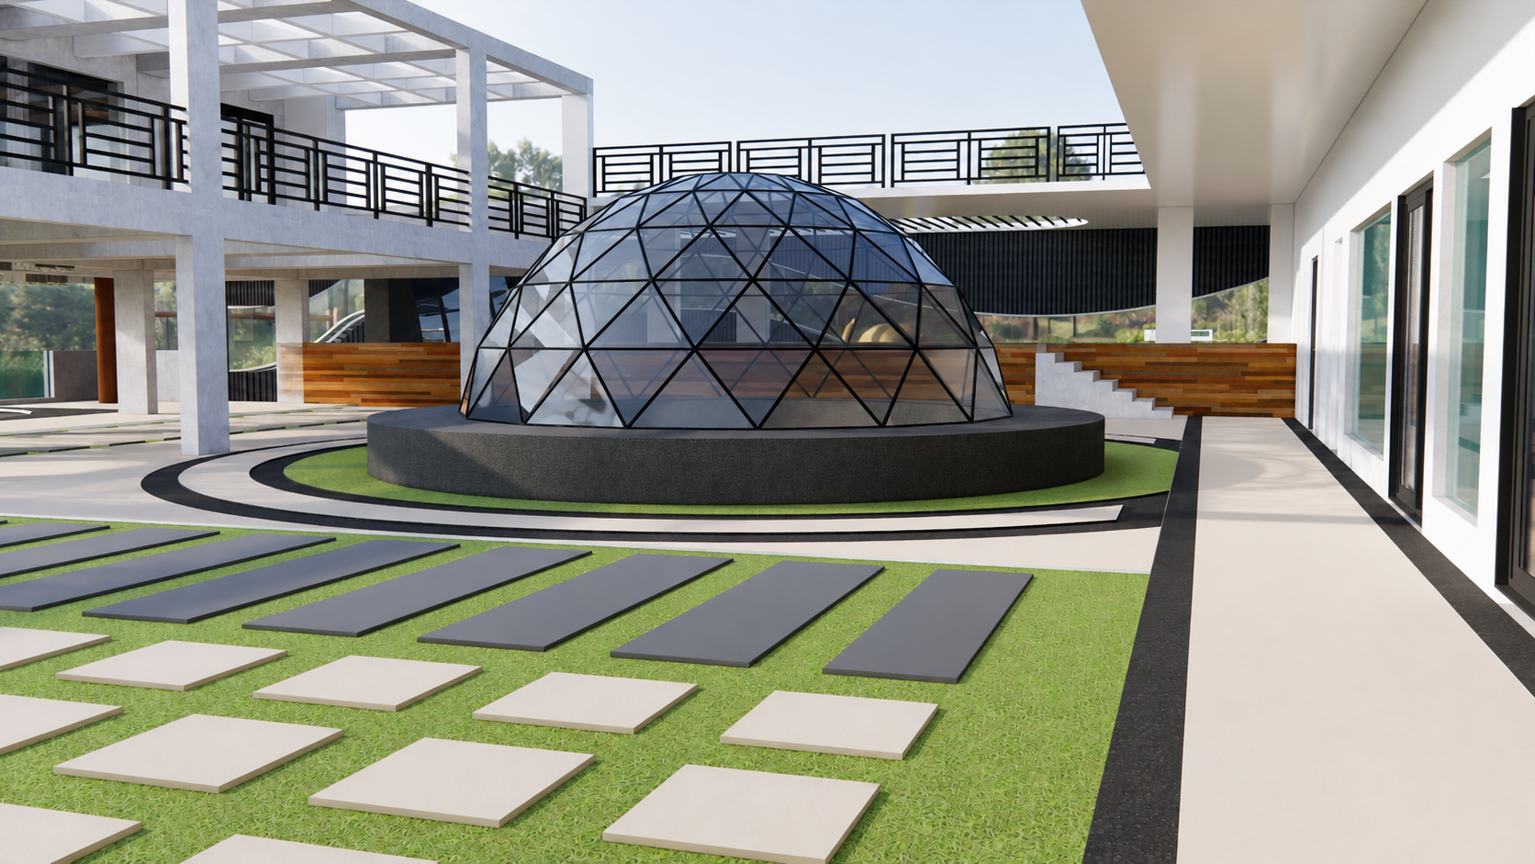

Slide 36
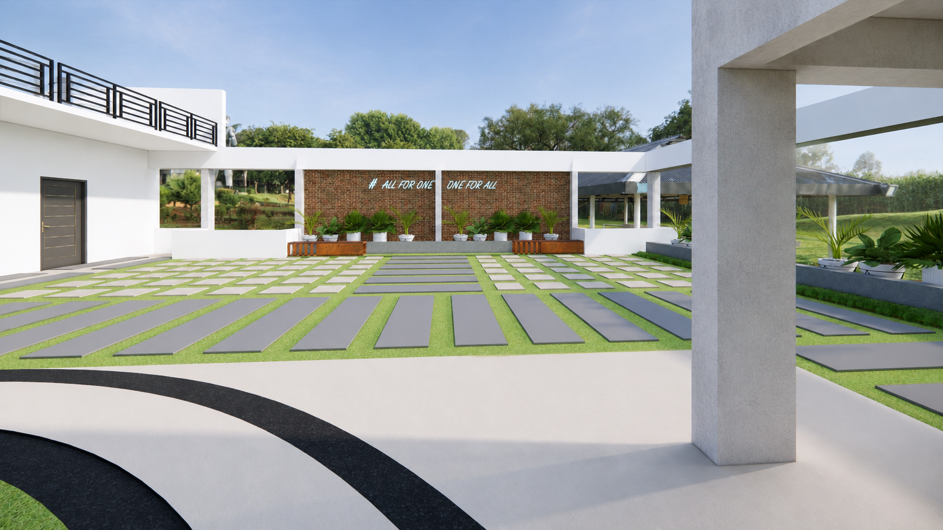

Slide 37
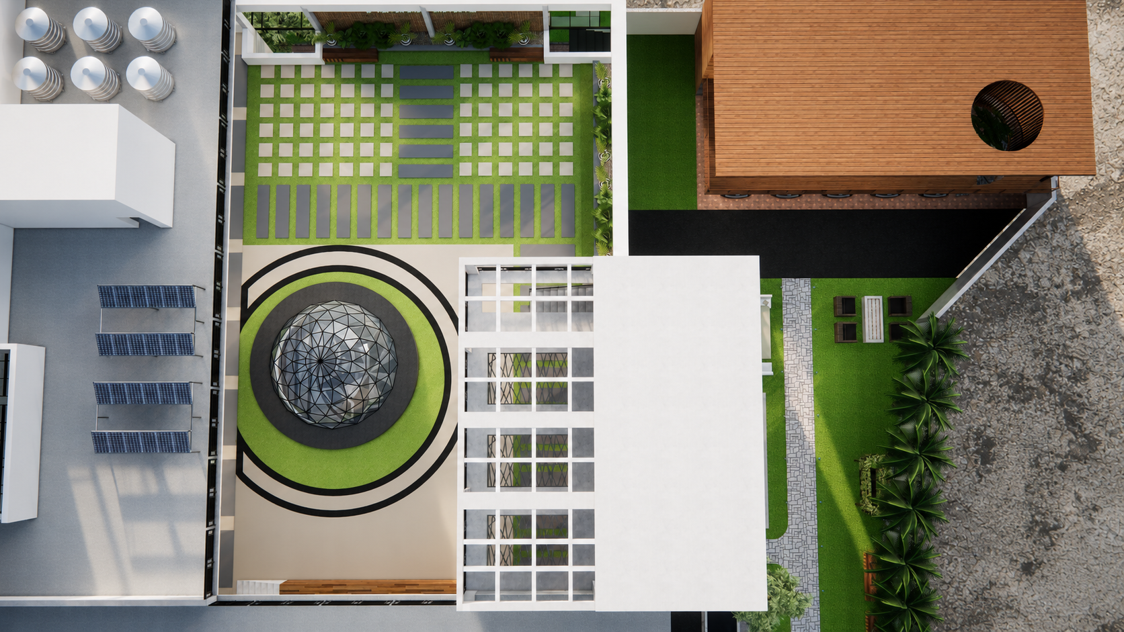

Slide 38
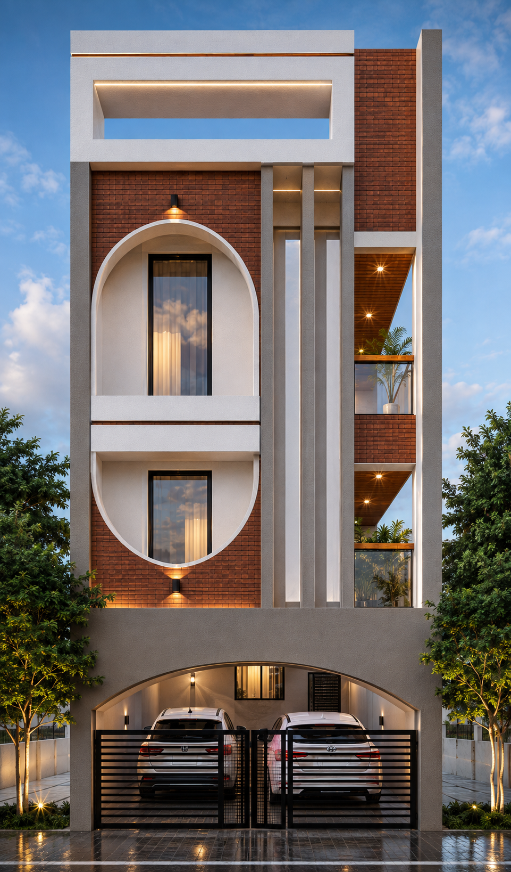
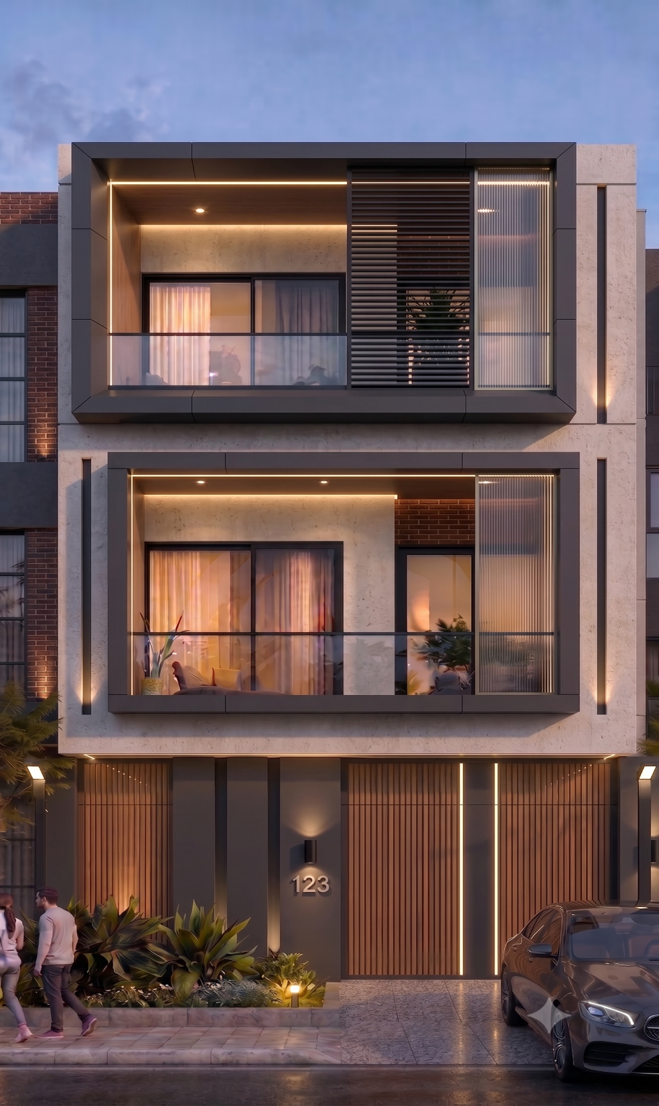
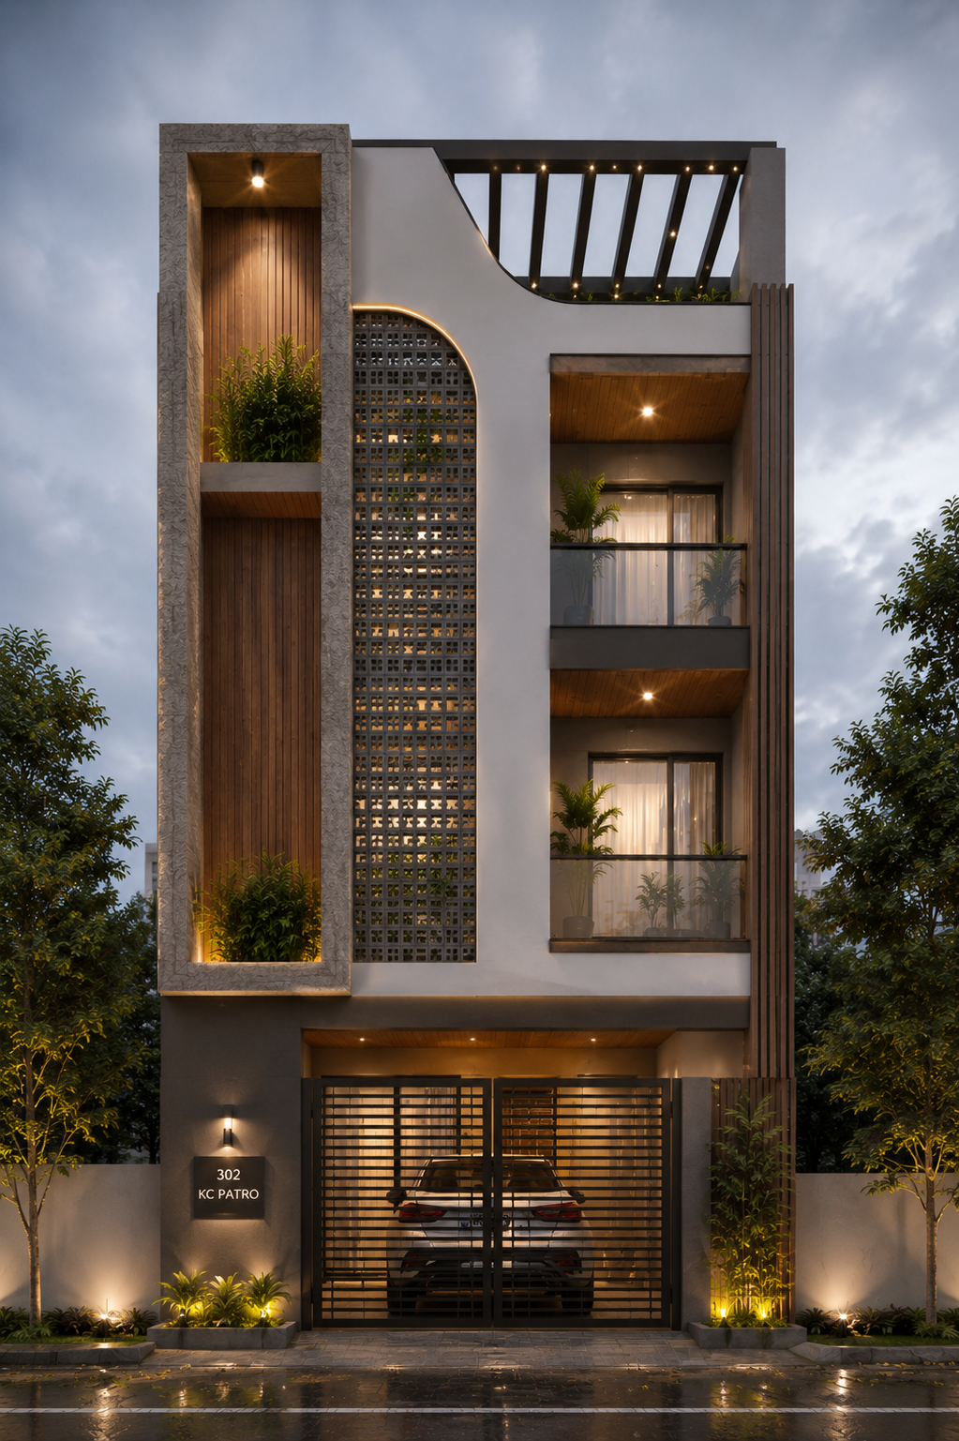
20 FEET NARROW HOUSE
ODISHA

